Slide 1
Data analysis and filtering
Professor Fabrice Pierron
University of Southampton

Slide 2
Summary
Performance evaluation
  Resolution, spatial resolution
Strain calculation
  Smoothing, filtering, reconstruction
Performance reporting
Mechanical data extraction

Slide 3

Performance evaluation (1/10)
Metrology
  Science of measurement
  Recommendations (vocabulary, definitions, good practice) available in GUM
Guide to the expression of uncertainty in measurement
http://www.bipm.org/en/publications/guides/gum.html

Slide 4


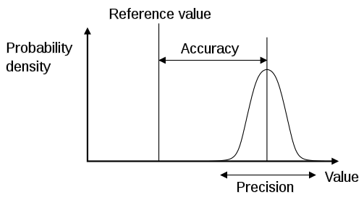
Performance evaluation (2/10)
Two types of errors: Random and Systematic
Accurate but not Precise
Large Random Error
Small Systematic Error
Precise but not Accurate
Small Random Error
Large Systematic Error
Words used interchangeably
Bias = Systematic error
Noise = Variance error = Random error
The new view is to categorize as Type A and Type B Errors
Copyright 2013 Sandia Corporation
Image from Wikipedia
Notes:
This is because a true bias error can be corrected, which leaves only a random error (along with any error involved in the correction).

Slide 5
Performance evaluation (3/10)
A newer approach categorizes errors into two types: Type A and Type B
Type A – Evaluated via statistical methods
Repeated measurements
Statistical distributions
  Normal, Log-normal, etc.
Copyright 2013 Sandia Corporation
Notes:
Both error types are propagated via the same sum-squared methods.

Slide 6

Performance evaluation (4/10)
A newer approach categorizes errors into two types: Type A and Type B
Type B – Evaluated by other means
Modeling approaches
Assumed probability distribution
Experimental expertise
The measurand Y is made up of X other input quantities. The function may be so complicated that it cannot be written down (Section 4.1.2).
$Y=f(X_{1},X_{2}$, …, $X_{N}$)
Mathematical modeling of the experiment taking into account all error sources is a valid and approved method of estimating uncertainty. (Section 3.4.1)
Copyright 2013 Sandia Corporation
Notes:
Both error types are propagated via the same sum-squared methods.

Slide 7
Performance evaluation (5/10)
Resolution
  Smallest value of the measurand (displacement, strain, slope etc…) that can be detected above noise
  Different from sensitivity: smallest value of measurand associated with a change of signal (typically related to CCD sensitivity and digitization here)
  Resolution is above sensitivity here because of camera noise

Slide 8
Performance evaluation (6/10)
Resolution
  Evaluate by mean and standard deviation of measurement on a still object in real testing conditions
    Error on geometrical model can be accounted for by performing rigid body mouvements
    Bias can be evaluated by a change of magnification (see DIC lecture)
  Always report these values when communicating results

Slide 9

Performance evaluation (7/10)
Spatial resolution
  Smallest distance between to INDEPENDENT measurements
  In DIC: spatial resolution in displacement is related to the subset size (not the shift!)
  In the grid method, spatial resolution is related to the grid pitch
  In interferometry, spatial resolution is the pixel
only 2 independent data points

Slide 10
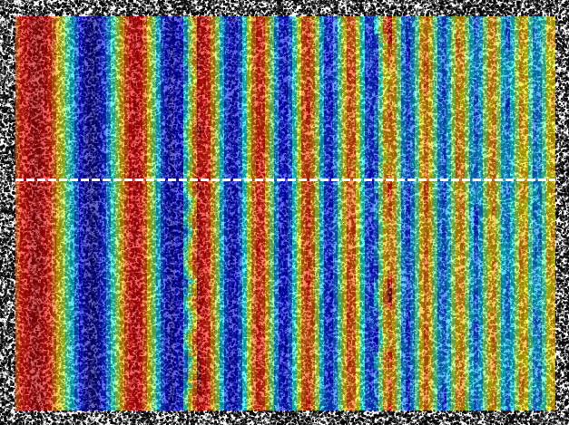
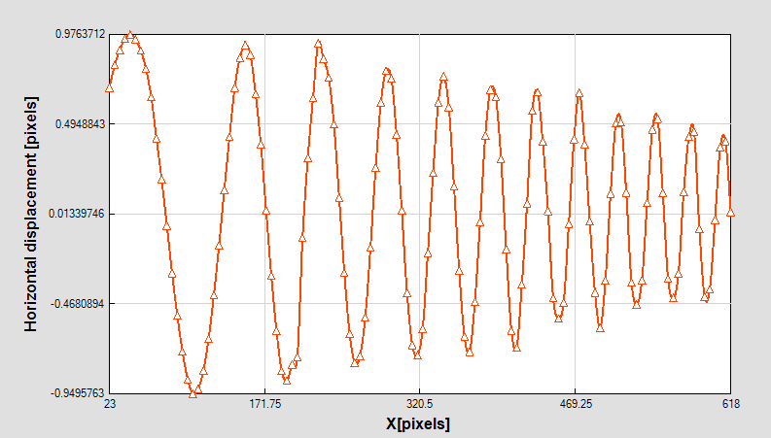
Performance evaluation (8/10)
Spatial resolution
  Previous definition not convenient (DIC/grid complex non-linear filters)
  Frequency cut-off approach
Cut-off frequency

Slide 11
Performance evaluation (9/10)
Practical implementation
  Just before performing your test, record at least two images of the still specimen (grid or DIC)
  Calculate displacement using the DIC or grid software
  Calculate the standard deviation of this displacement map. This can be used to estimate the resolution in displacement
  Check that the mean is lower than the standard deviation
  Report the resolution in displacement with your data

Slide 12
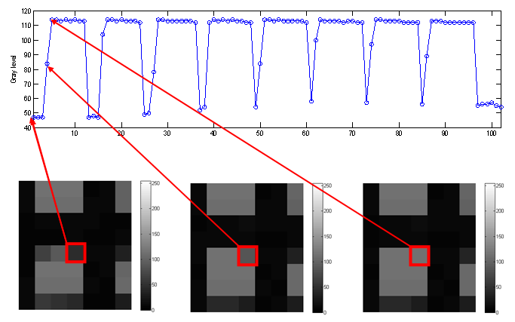
Performance evaluation (10/10)
Noise
  Camera dependent !!
  Example: Shimadzu HPV-1 (Ultra high speed camera)

Slide 13
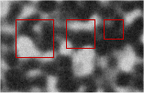
Spatial resolution (1/9)
1000 x 1000 images, 8 bit
41
31
21

Slide 14
Spatial resolution (2/9)
Analytical displacement field
Synthetically deformed images
DIC and comparison with reference displacement of 1 in amplitude
2D DIC, affine shape function, SSD criterion, bicubic spline interpolation (MatchID)

Slide 15
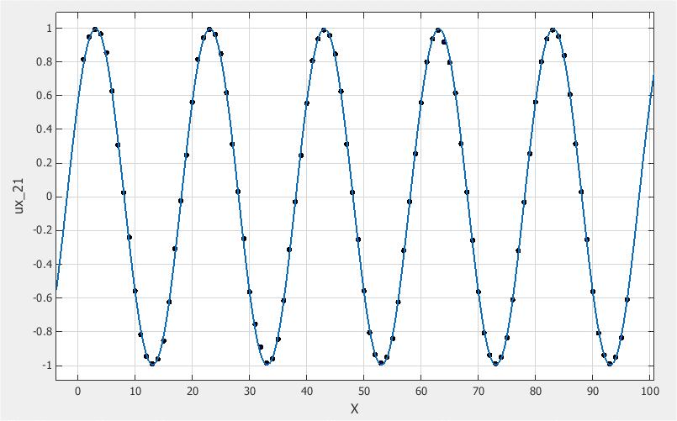
Spatial resolution (3/9)
Effect of subset size: 21 (step 50%)
Amplitude: 0.996 - Error: 0.4%

Slide 16
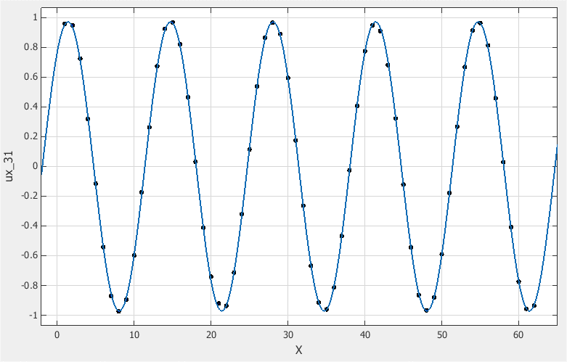
Spatial resolution (4/9)
Effect of subset size: 31 (step 50%)
Amplitude: 0.972 – Error : 2.8%

Slide 17
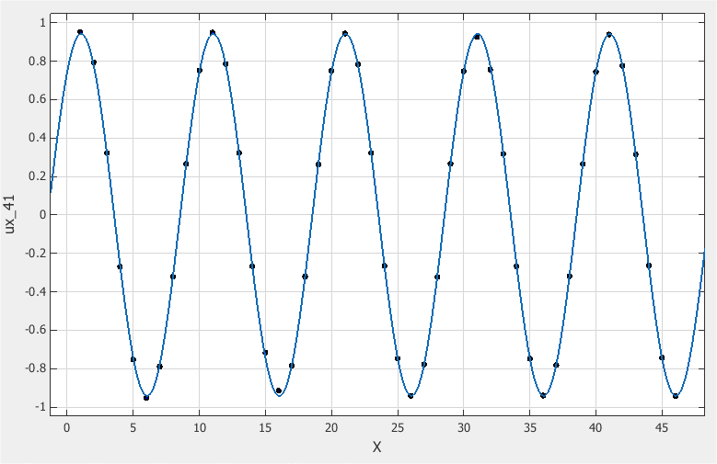
Spatial resolution (5/9)
Effect of subset size: 41 (step 50%)
Amplitude: 0.942 – Error : 5.8%

Slide 18
Spatial resolution (6/9)
Spatial resolution for subset size 41 (step 50%)
5% error
Resolution: 0,012 (standard deviation of displacement noise map, max of components)

Slide 19
Spatial resolution (7/9)
Effect of shape function (subset size 41, step 50%) - quadratic
5% error
Resolution: 0.041 (standard deviation of displacement noise map, max of components)

Slide 20
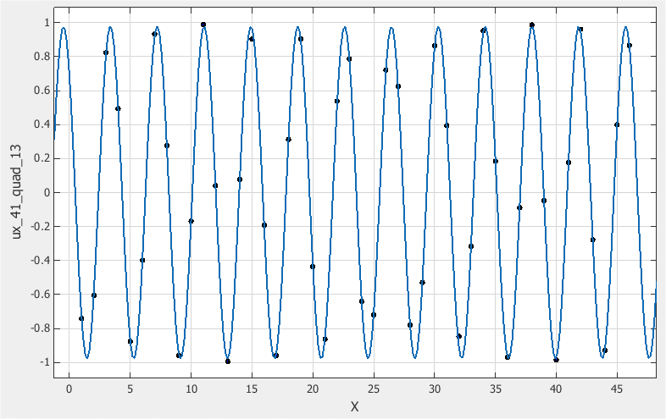
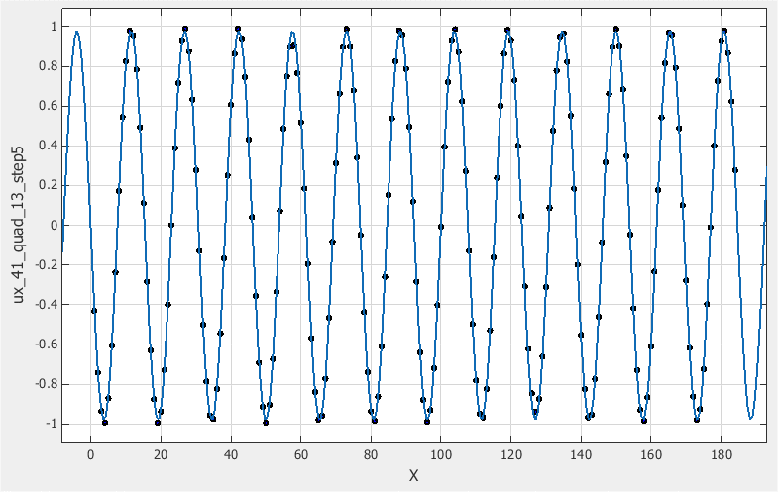
Spatial resolution (8/9)
Effect of step size
Large step size
Small step size

Slide 21
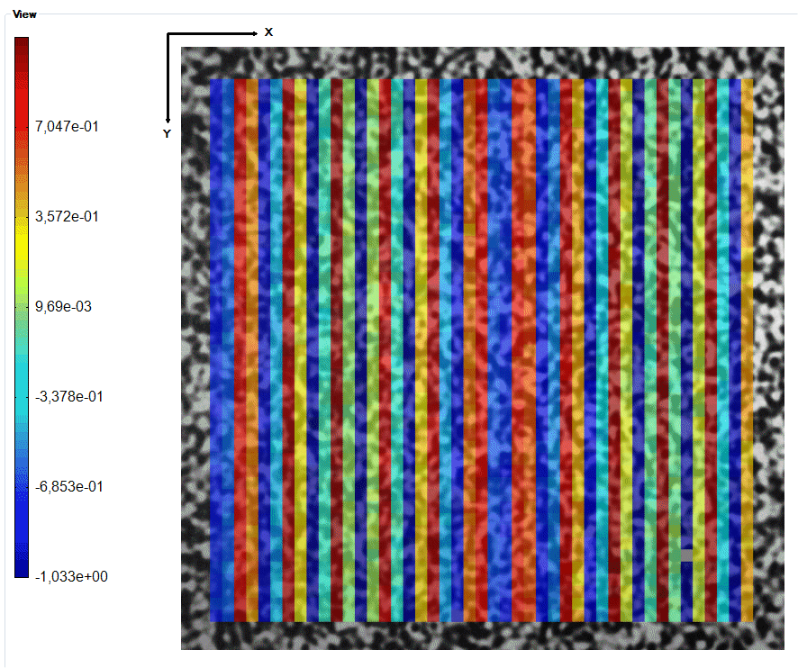
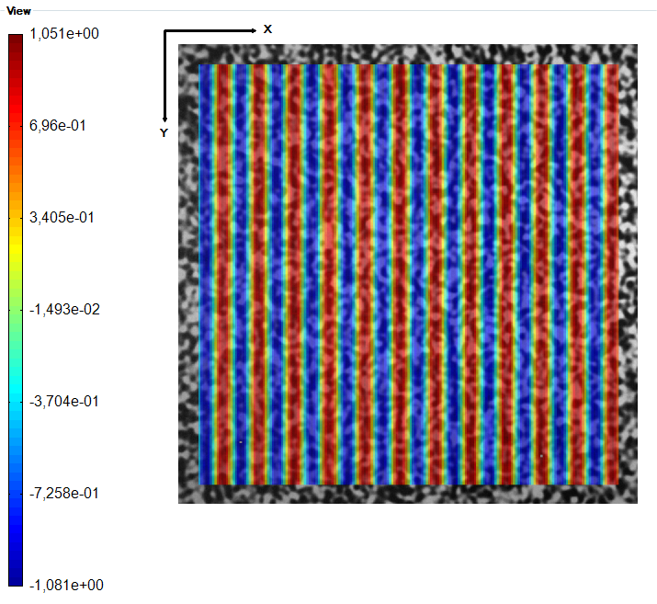
Spatial resolution (9/9)
Effect of step size
Better sampling but same spatial resolution!

Slide 22
Strain calculation (1/20)
From displacements to strains
  Strains (small deformation, small strain)
  Simplest way to compute strains: finite differences
L

Slide 23
Strain calculation (2/20)
From displacements to strains
  Differentiation amplifies noise
σ
E
x
x
E₁
x
x
x
E₂≠E₁
ε

Slide 24
Strain calculation (3/20)
From displacements to strains
  One thing to remember: strain is a relative displacement over a gauge length
  To improve resolution:
    Increase resolution on ΔL
    Increase the gauge length L
  Some basic figures:
    If displacement resolution is 0.01 pixel, then resolution on ΔL is 0.02 pixels. If the strain is computed between two DIC subsets set apart by say 20 pixels, the raw strain resolution will be 2.10⁻³
    To improve it, smoothing is necessary

Slide 25
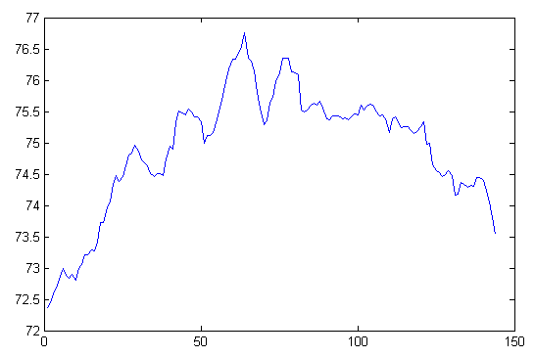
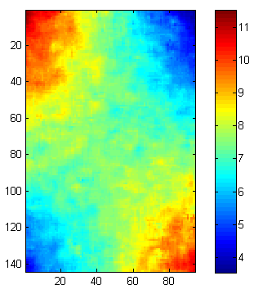
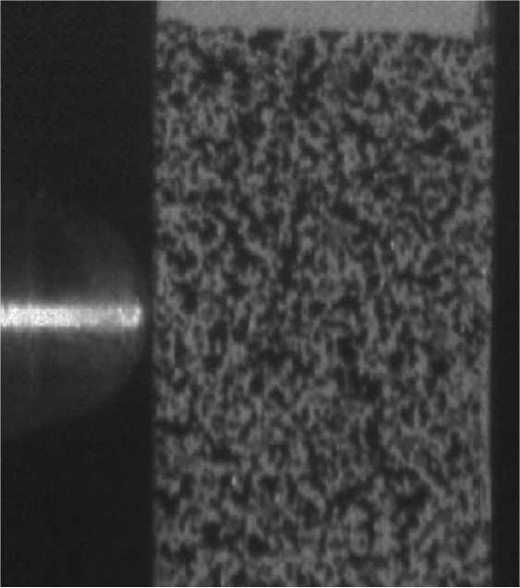
Strain calculation (4/20)
From displacements to strains
  Finite differences
x
y

Slide 26
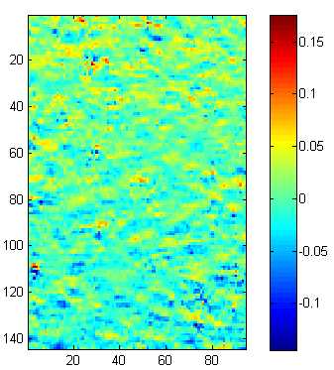
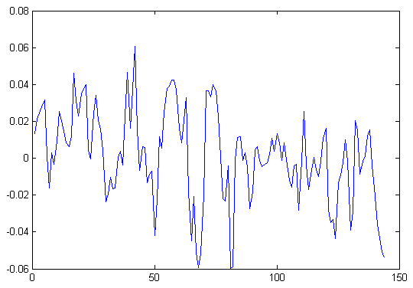
Strain calculation (5/20)
From displacements to strains
  Finite differences

Slide 27
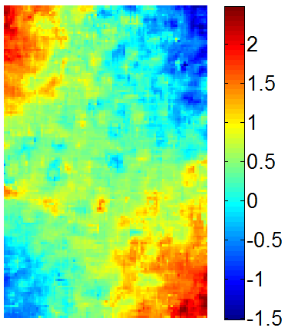
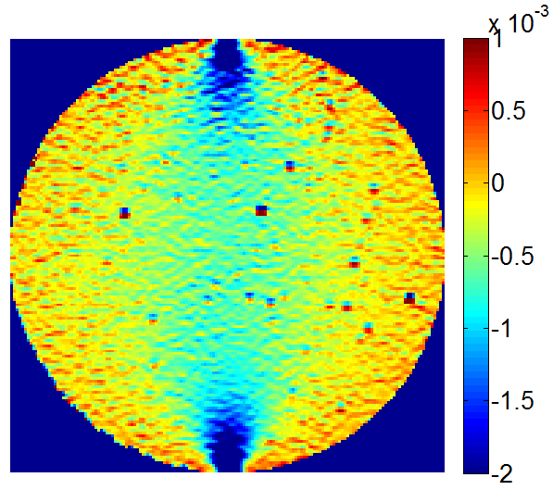
Strain calculation (6/20)
Smoothing
  Low pass filter
FFT
FFT
Signal
Noise
Modulus of FFT
Signal+ noise
Noise + signal
Spatial frequency
Spatial frequency cut-off: regularization parameter

Slide 28
Strain calculation (7/20)
Mean filtering
  Replace central value by mean of neighbours (kernel n). Improve resolution by
  Regularization parameter: kernel
1 | 1 | 1
1 | 1 | 1
1 | 1 | 1

Slide 29
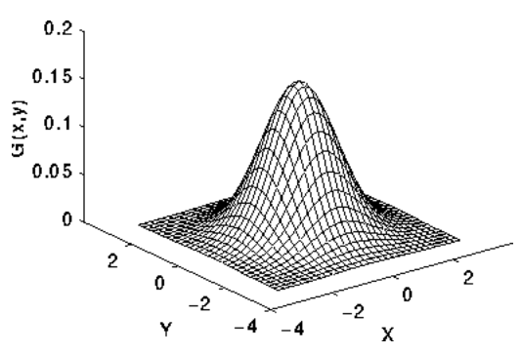
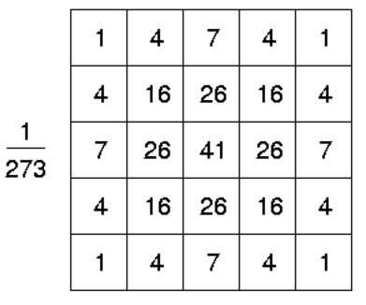
Strain calculation (8/20)
Gaussian smoothing
  Replace central pixel value by weighted average of neighbouring pixels
  Removes outliers, low pass filter, tuning parameter: kernel

Slide 30
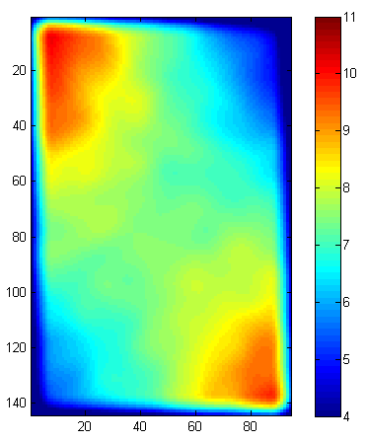
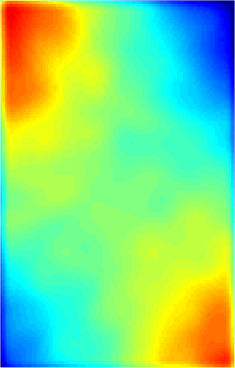
Strain calculation (9/20)
Gaussian smoothing
  Kernel of 8
Problem with the edges

Slide 31
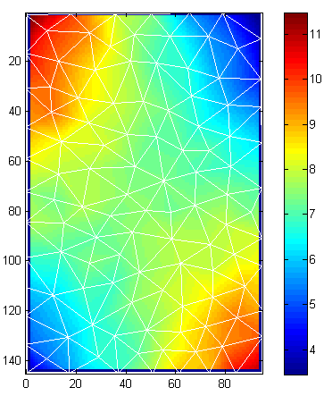
Strain calculation (10/20)
Finite element smoothing
  Use piecewise functions to reconstruct the displacements
  Identify nodal values using least-square approach
FE mesh
Size 10 pixels

Slide 32
Strain calculation (11/20)
Global polynomial smoothing
  Find the polynomial coefficients that fit the data best in the least-square sense
  Strain by finite difference of smoothed data (or analytically from polynomial)
  Tuning parameter: polynomial degree
  Very efficient low pass filter
  Instabilities towards the edges
  Strain at one point depends on displacements all over the specimen!

Slide 33
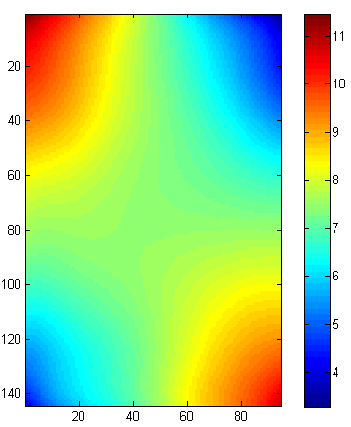
Strain calculation (12/20)
Global polynomial smoothing
  Degree 8

Slide 34
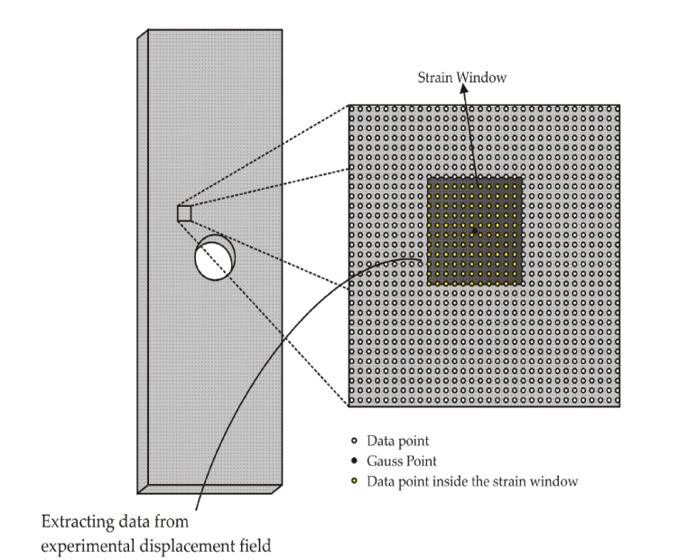
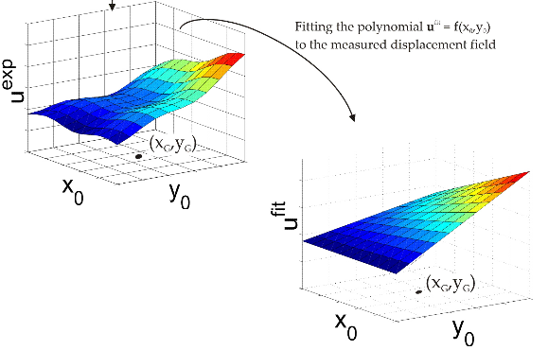
Strain calculation (13/20)
Local polynomial smoothing
Least square fit

Slide 35
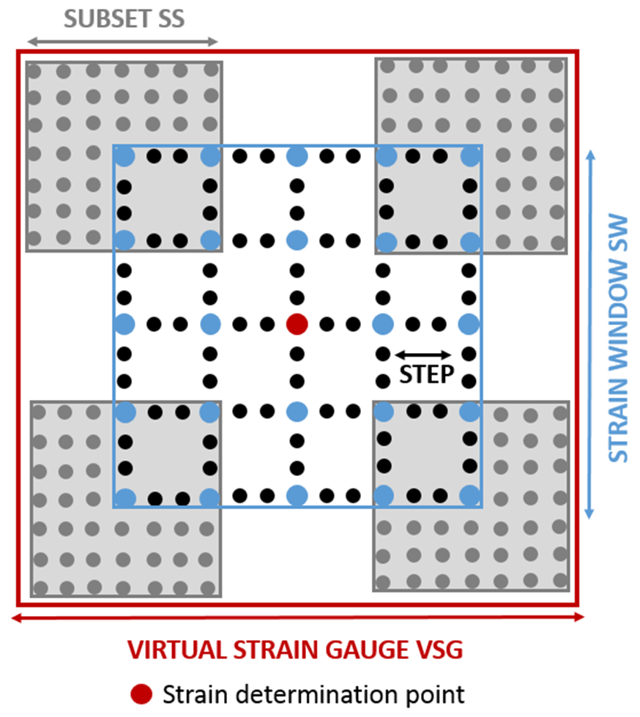
Strain calculation (14/20)
Local polynomial smoothing
  Virtual Strain Gauge size (VSG)
Virtual strain gauge size
VSG = [ (SW-1) x ST] + SS
SW = Strain window (in data points)
ST = Step size (pixels)
Depends on both strain window and subset size
Here:
Subset (SS) = 7 ; Step (ST) = 3, Strain window (SW) = 5
VSG = 19 pixels

Slide 36
Strain calculation (15/20)
Spatial resolution vs resolution
  Smoothing improves resolution and degrades spatial resolution
  Smoothing spreads noise spatially (blurs information)
  Strain resolution meaningless without the spatial resolution (‘gauge length’).
  IMPORTANT: regularization parameter (degree, kernel, VSG etc…) more important than smoothing method!

Slide 37
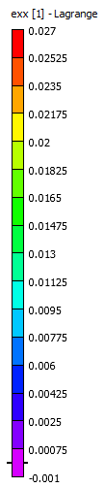
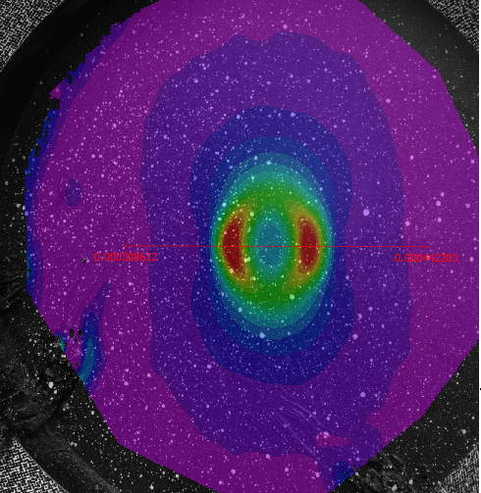
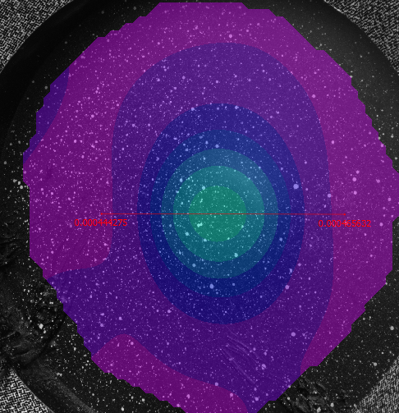
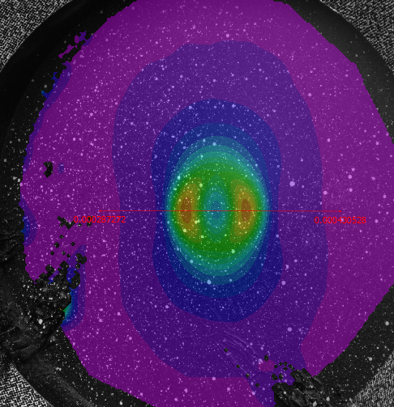
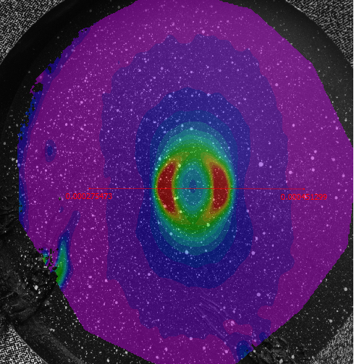
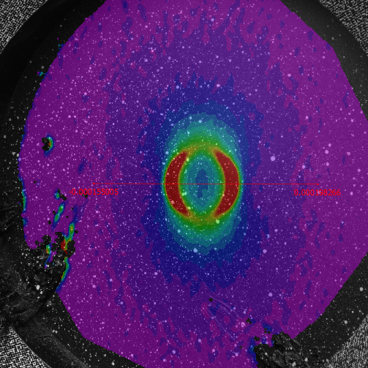
Strain calculation (16/20)
Effect of smoothing
Subset = 91
Step = 23
Strain Filter = 15
Virtual Gage = 37 mm
Subset = 29
Step = 8
Strain Filter = 15
Virtual Gage = 13.1 mm
Subset = 29
Step = 3
Strain Filter = 5
Virtual Gage = 1.6 mm
Subset = 71
Step = 5
Strain Filter = 15
Virtual Gage = 8.2 mm
Subset = 71
Step = 5
Strain Filter = 5
Virtual Gage = 2.7 mm
Copyright 2013 Sandia Corporation

Slide 38
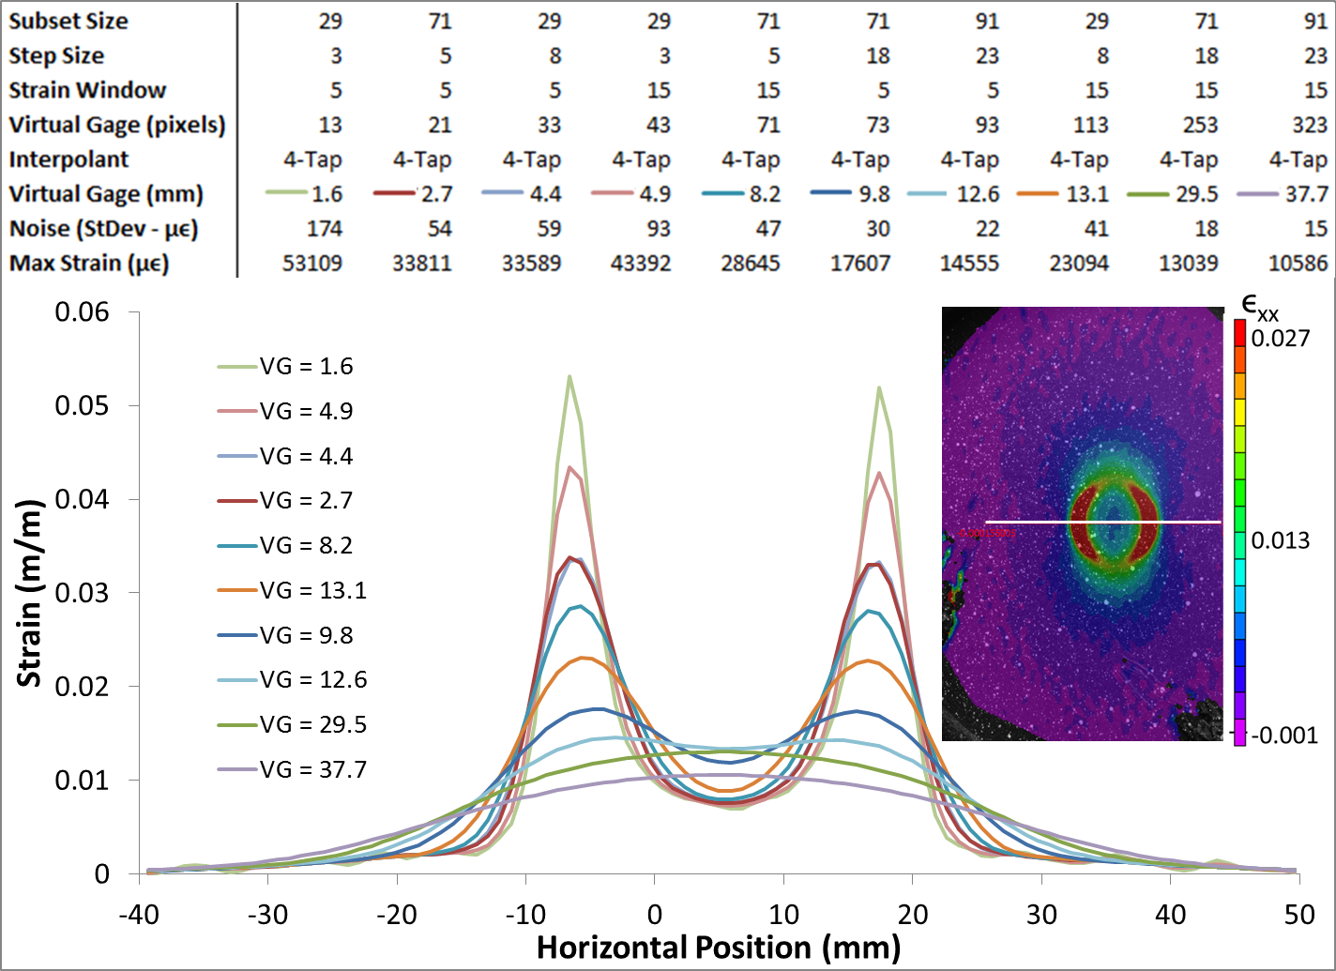
Strain calculation (17/20)
Example
Copyright 2013 Sandia Corporation

Slide 39
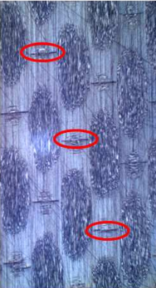
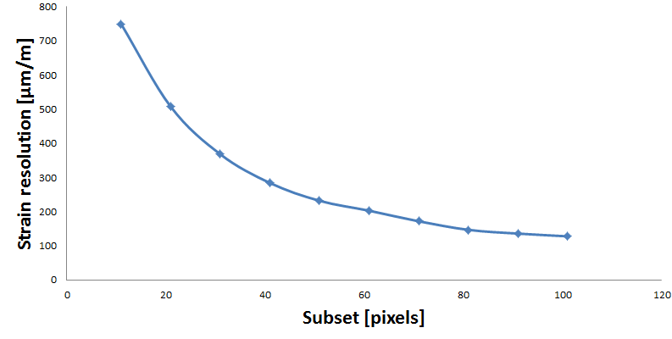
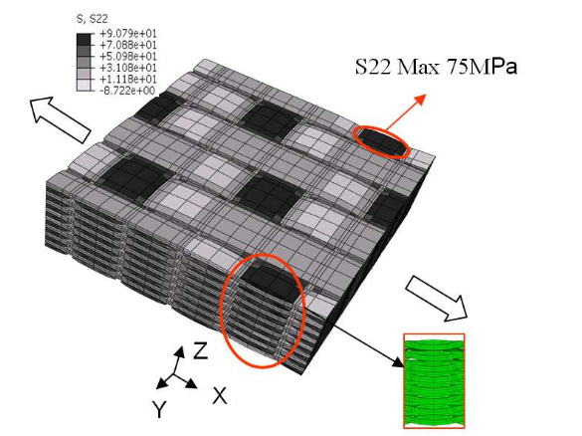
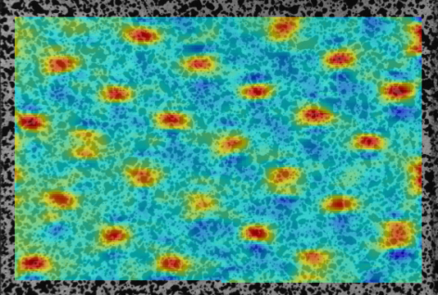
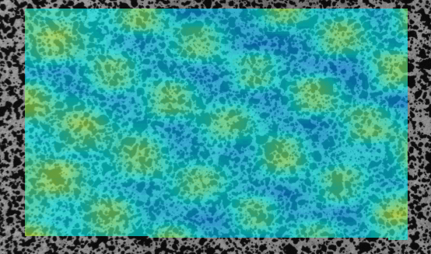
Strain calculation (18/20)
Virtual Strain Gauge = 50 pixels
Spatial resolution

Slide 40
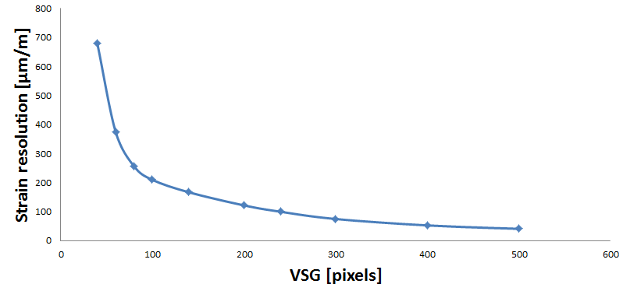
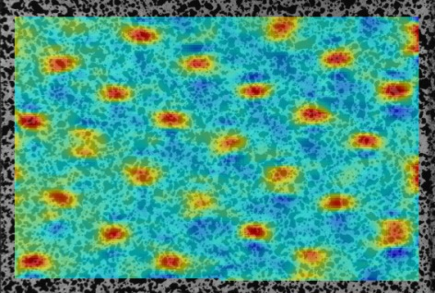
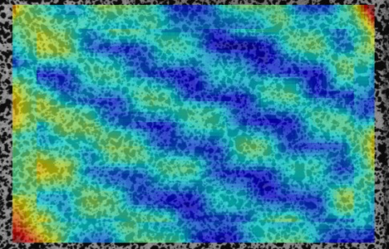

Strain calculation (19/20)
Subset = 21 pixels

Slide 41
Strain calculation (20/20)
Spatial resolution in strain
  Standard procedure feasible for all techniques still missing
  Idea: spatial frequency approach
    Define a cutting frequency in the Fourier space
    Work underway
  In any case, always precise method and tuning parameter when reporting results

Slide 42
Performance evaluation
Always evaluate performances before test
Minimal procedure
  Take two sets of still images (better: out of plane movement)
  Compute displacement
    Compute standard deviation: displacement resolution
  Compute strains
    Compute standard deviation: strain resolution
  Report key parameters
    Subset for DIC, grid size (Grid Method), camera type, camera spatial resolution etc.
  Report resolution (in the future, add spatial resolution)

Slide 43
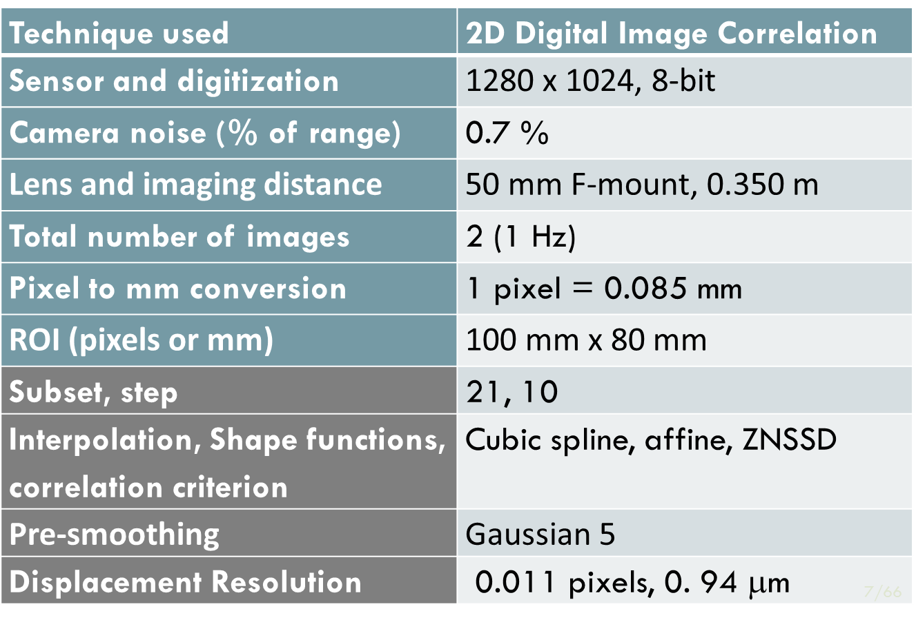
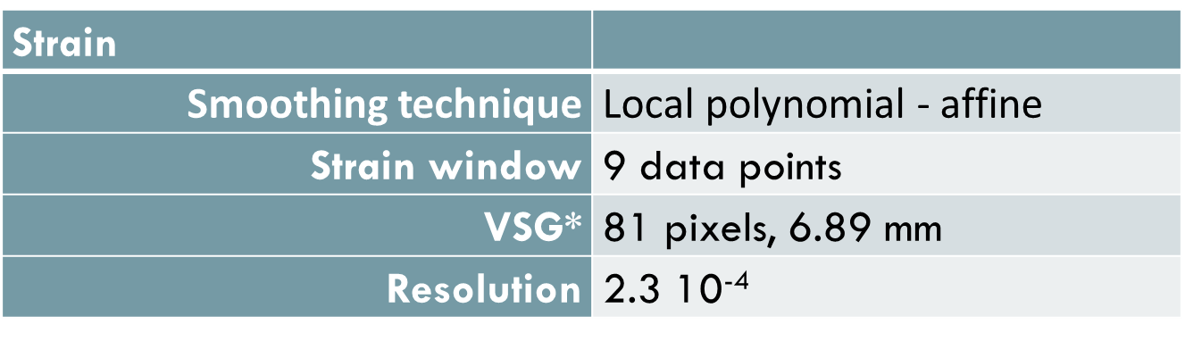
Reporting
Always report performances with data

Slide 44
Extracting mechanical data
from strain fields

Slide 45
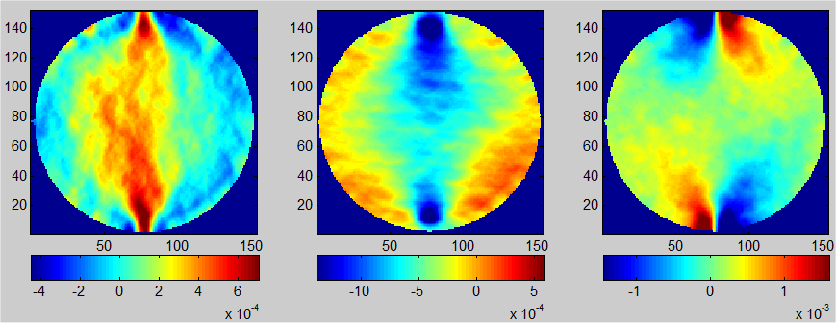
Statement of the problem
Problem to solve
Force
Geometry
+
Extract E and ν ?
Analytical solution
Virtual Fields Method (see this afternoon)

Slide 46
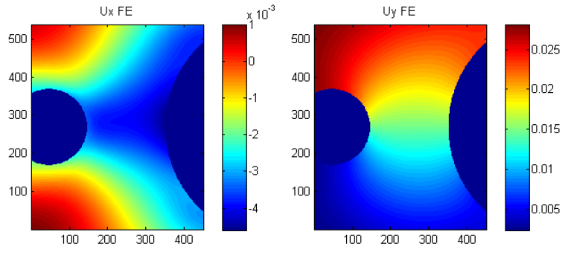
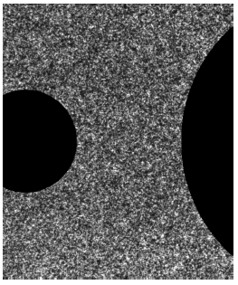
Speckle deformation simulation (1/2)
DIC is a rather complex and non-linear process; the results of depend on many parameters, including the speckle pattern
Any realistic UQ on the mechanical parameters requires to take into account the measurement process: numerical speckle image deformation tool
Start with FE generated displacement map and a speckle pattern (real or artificially generated)

Slide 47



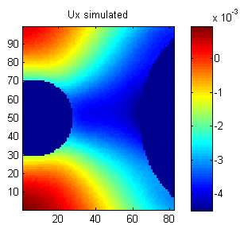
Speckle deformation simulation (2/2)
Principle
New pixel intensity: average of
Doing this for all pixels leads to a deformed image
≠
DIC leads to simulated displacements affected by the correlation

Slide 48
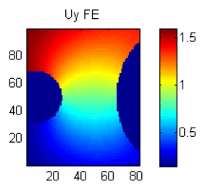



Displacement error
y
Results
Vertical displacement in pixels
Bias: low spatial frequency error
1.5 pixel displacement
1.5 sine period

Slide 49




Strain error
y
VSG=151 pixels
SR=211 pixels
Larger error
(larger gradients)

Slide 50


Strain error with noise on images
y
VSG=151 pixels
Much larger than systematic error

Slide 51




UQ on parameters / deformation (1/5)
Rossi M., Lava P., Pierron F., Debruyne D., Sasso M., International Journal of Solids and Structures, Strain, 2015.
Illustration
  Synthetic strain map containing the effect of, say, local stiffness variations in the material (the 1 to 4 figures)
integration
DIC

Slide 52



UQ on parameters / deformation (2/5)
Global reconstruction error
  Wrong criterion
Reconstruction
error (RMS):
0.0035
Reconstruction
error (RMS):
0.0017

Slide 53


UQ on parameters / deformation (3/5)
When performing material identification
  Error on material parameters are relevant, not so much error on strains
  Illustration
Field of view in red
FE model, glass/epoxy UD composite
Rossi M., Pierron F., International Journal of Solids and Structures, 2012.

Slide 54



UQ on parameters / deformation (4/5)
Shear strain maps obtained by image deformation plus different levels of smoothing
VSG=5 pixels
(no smoothing)
VSG=60 pixels
(local polynomial)
Which one is ‘the best’?

Slide 55





UQ on parameters / deformation (5/5)
Because reference stiffness components are known, an error function can be built-up (RMS error)
2 x error
Same error
Larger error
Same error
Lower error
Lower error
10
30
150
(grey level)

Slide 56




Smoothing vs reconstruction error (1/3)
Systematic error coming from low pass filtering effect of measurements
  Illustration: ‘Arcan’ test on foam (tension/shear on rectangular specimen)
FE strains
Simulated DIC + smoothing
Wang P., Pierron F., Thomsen O.T., Experimental Mechanics, 2013
Wang P., Rossi M., Lava P., Pierron F., Thomsen O.T., Strain, 2015

Slide 57
Smoothing vs reconstruction error (2/3)
The total error is the sum of
  Systematic error (or bias, or reconstruction error), from the low pass filtering effect of the measurements. It increases with VGS
  Random error arising from noise, decreases with VSG
DIC parameters can be optimized using synthetic measurements
Systematic error obtained by using noise free images (reference and synthetically deformed)
Random error obtained by performing many identification with different copies of noise, taking the mean and subtracting the systematic error

Slide 58

Smoothing vs reconstruction error (3/3)

Slide 59


Experimental validation – 1/3
Comparison of strain maps
FE/DIC simulation with noise and reference stiffness
Experimental

Slide 60

Experimental validation –2/3
  Mean, average over 20 repetitions
  (results in MPa)

Slide 61

Experimental validation – 3/3
  Coefficients of variation, average
  over 20 repetitions (results in MPa)

Slide 62
Conclusion
DIC technique: complex non-linear filter
Post-processing: another layer of non-linear filtering
Important to systematically evaluate and report performances (in papers, reports etc)
Post-processing depends on objectives
  Strain evaluation
  Stiffness / constitutive model identification
  Acceleration measurements
  ...

