Slide 1
High speed imaging
Professor Fabrice Pierron
University of Southampton

Slide 2
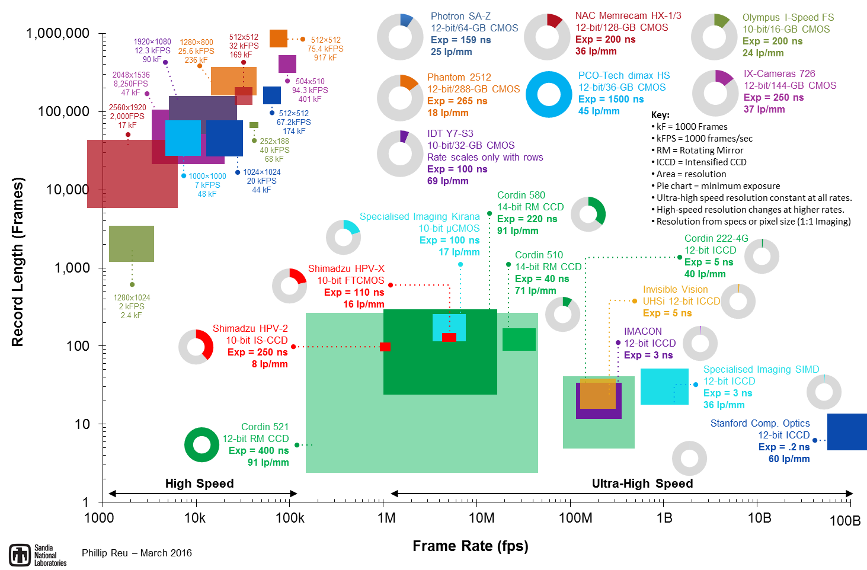
High vs Ultra-high speed imaging
Reu, P. L., & Miller, T. J. (2008). Journal of Strain Analysis for Engineering Design, 43(8), 673-688.

Slide 3
High speed cameras
Standard single sensor high speed camera
  CMOS (mainly) or CCD sensors
  Limitation for frame rate: memory read-out
  Possible to compromise spatial resolution for temporal resolution
    Image with less pixels can be transferred more quickly into memory
  Current state of the art:
  Vision Research Phantom v2511
    1280 x 800 resolution - 25,600 fps
    28 μm pixel size !
  Equivalent specs with Photron

Slide 4
Ultra-high speed imaging
Different strategies to overcome the memory read-out issue
Each sensor captures one image only
  Light spread to sensors through rotating mirror
  Beam-splitter (gated intensified cameras, ICCD)
The data is stored on the sensor
  In-situ storage CCD (IS-CCD)

Slide 5
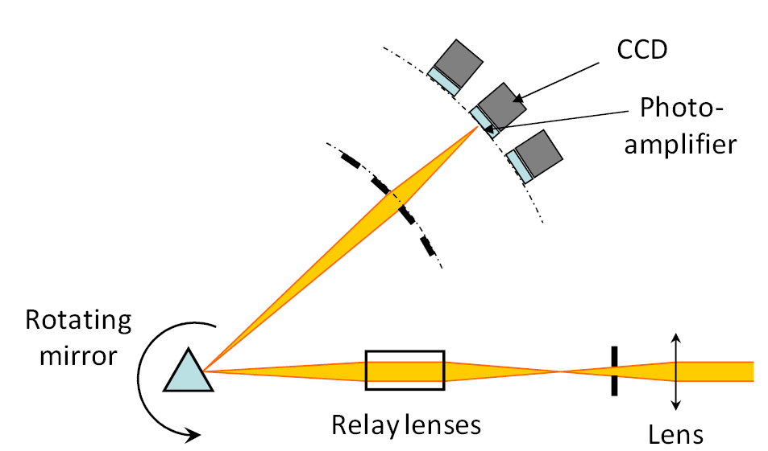
Rotating mirror camera (1/5)
Each sensor captures one image only
Light spread to sensors through rotating mirror

Slide 6
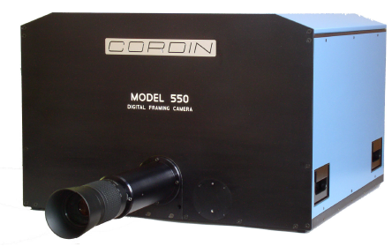

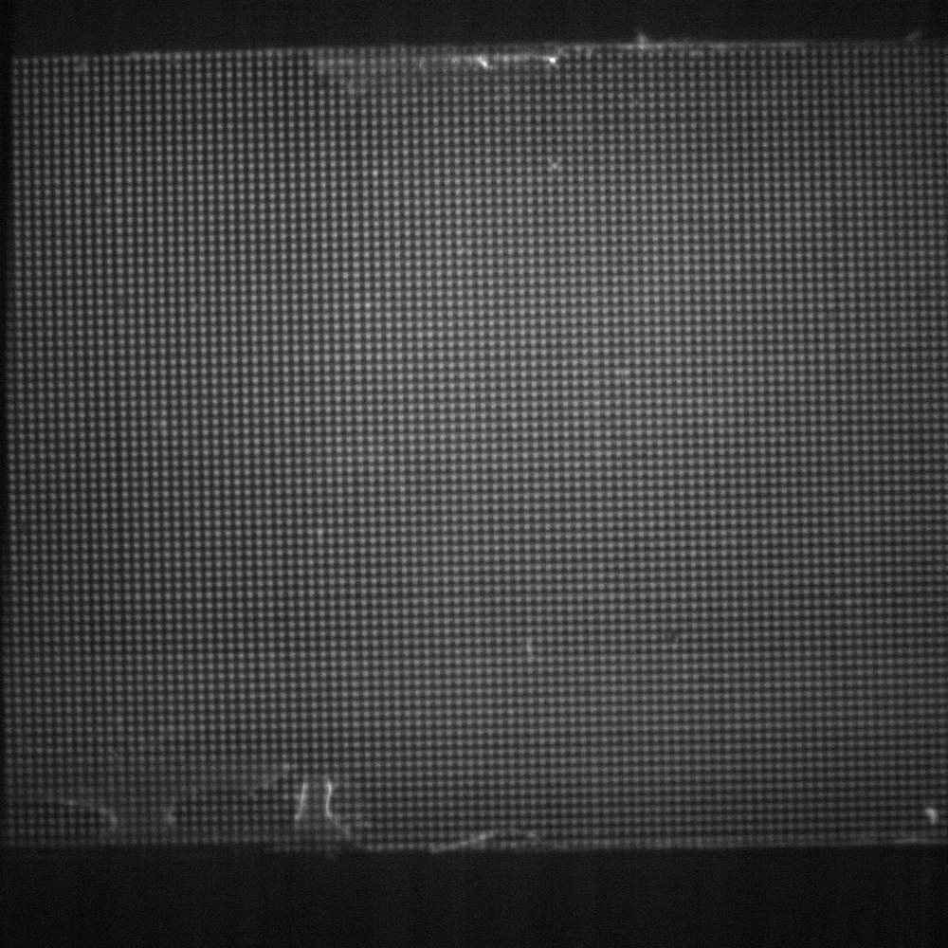
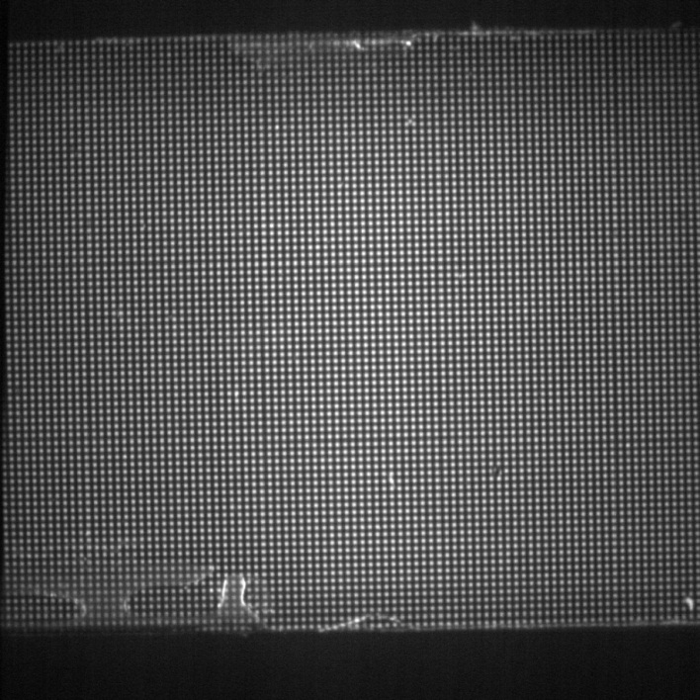
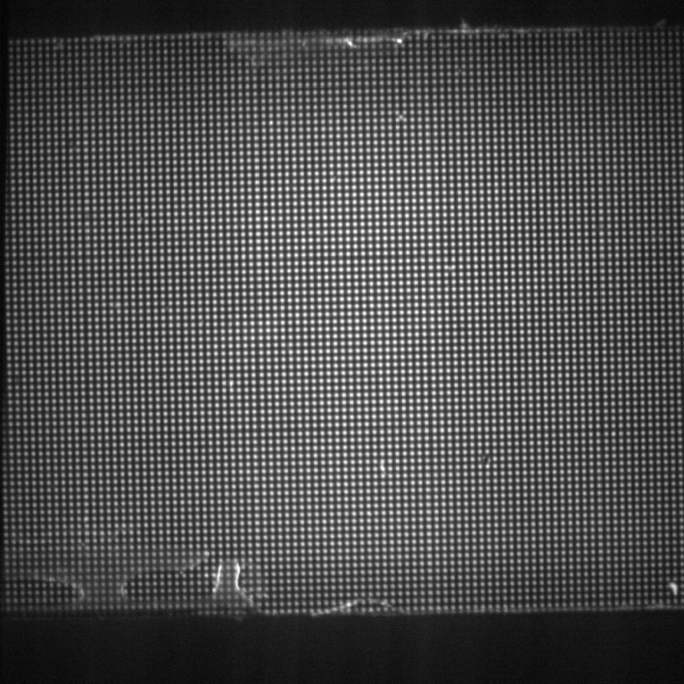


Rotating mirror camera (2/5)
Example: Cordin 550-62
  62 1Mpixel sensors
  Up to 4 Mfps
Problems
  Different sensors:
  different field of view
  different brightness
Example:
  image of a stationary
  grid

Slide 7
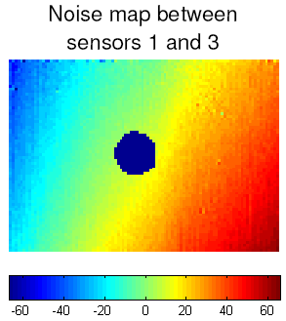
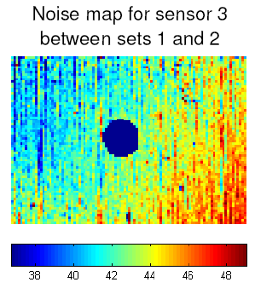
Rotating mirror camera (3/5)
Need to compare images from the same sensor
Ux in
μm
Range: 120 μm
Range: 10 μm

Slide 8
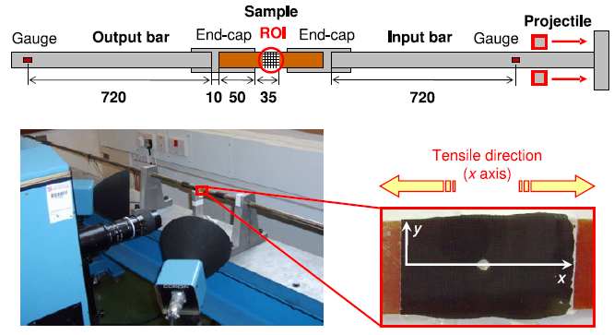
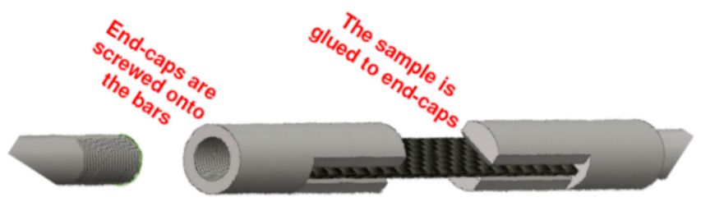
Rotating mirror camera (4/5)
Example
Dimensions: mm

Slide 9
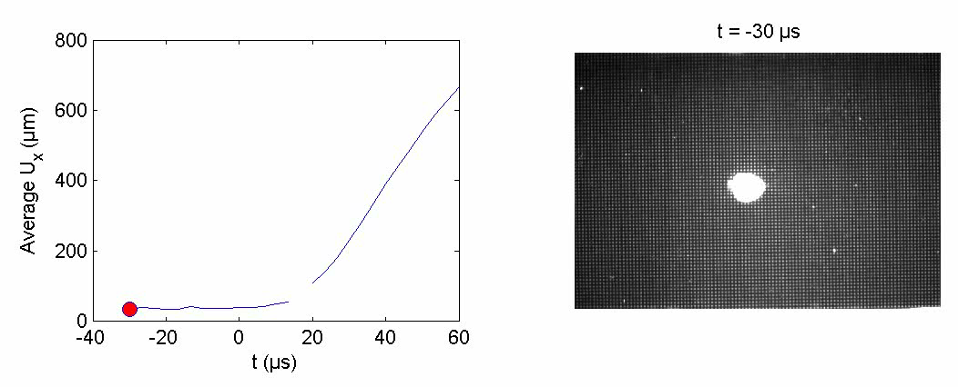
Rotating mirror camera (5/5)
Longitudinal displacement
Ux in μm
Moulart R., Pierron F., Hallett S.R., Wisnom M.R., Experimental Mechanics, 2011.

Slide 10
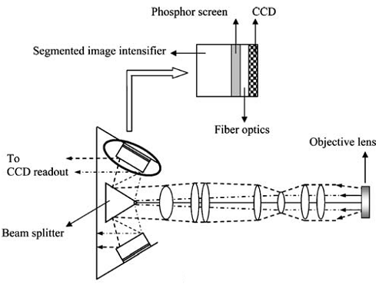
Intensified gated camera (1/7)
Each sensor captures one image only
Light spread to sensors through prismatic beam splitter

Slide 11
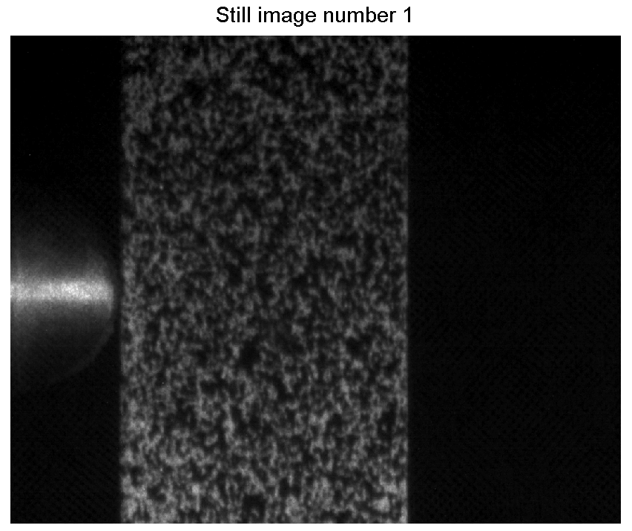

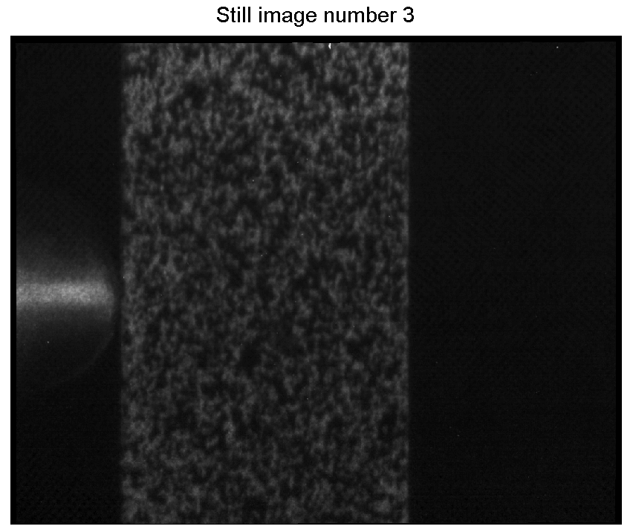
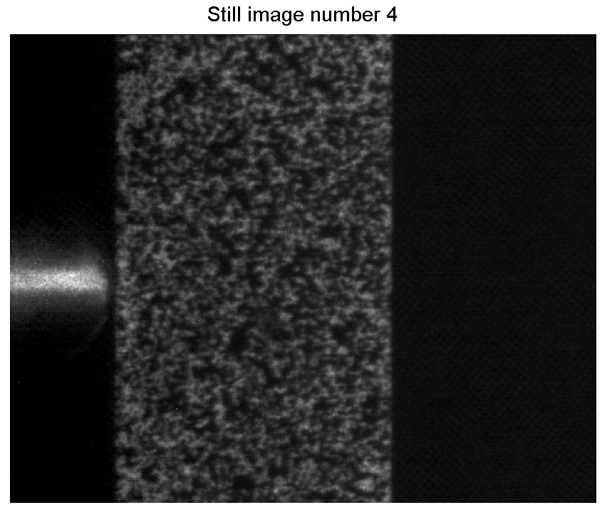

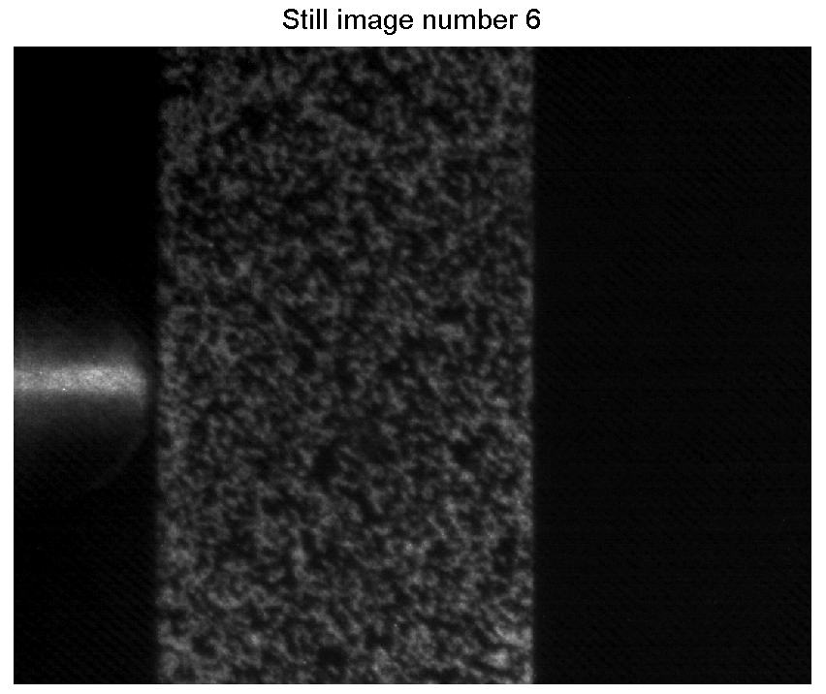
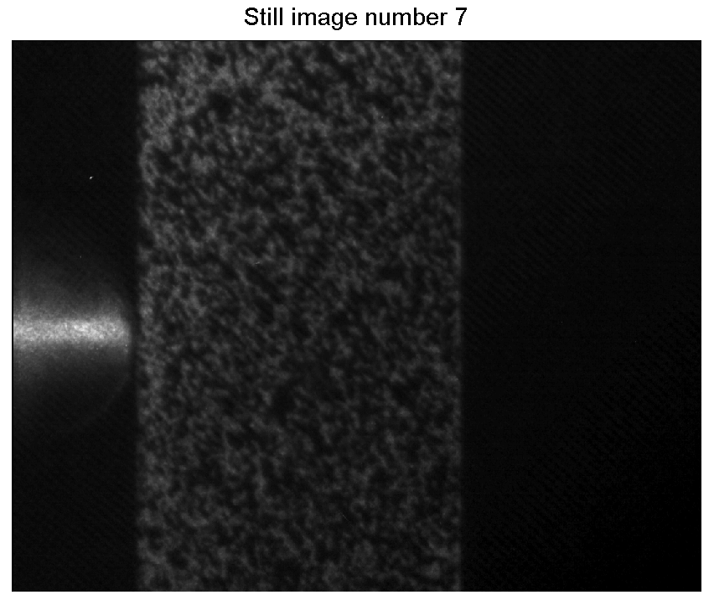
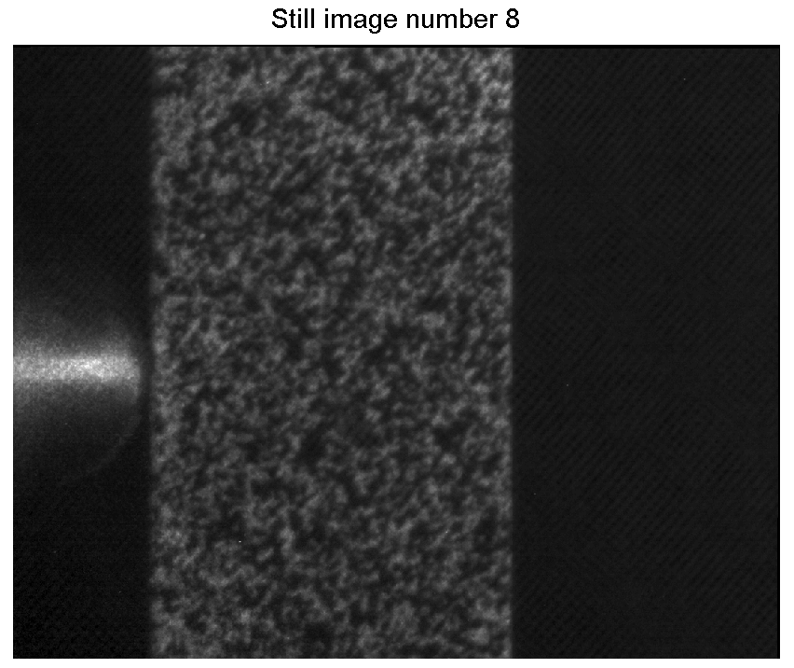
Intensified gated camera (2/7)
Different sensors:
  Same issue as rotating mirror technology
  Example: DRS IMACON 200: 16 images at up to 200 Mfps (!)
Image of static speckle pattern

Slide 12
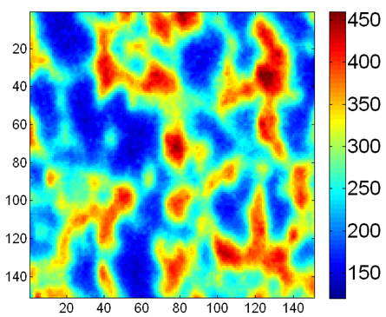
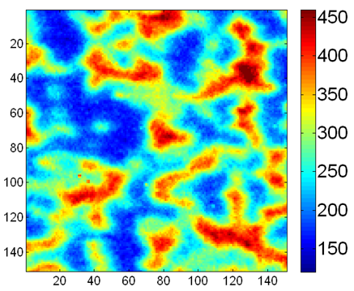
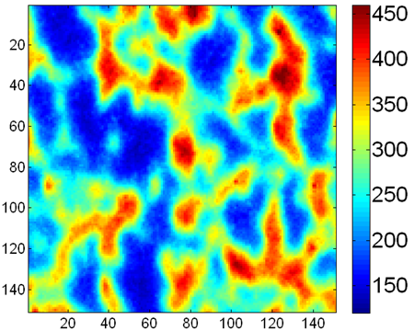
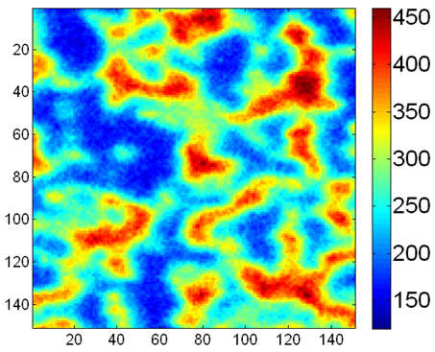
Intensified gated camera (3/7)
Problem related to grain size of phosphor screens (‘leakage’)
sensor 1
sensor 2
Sequence 1
Image of static speckle pattern
Sequence 2

Slide 13
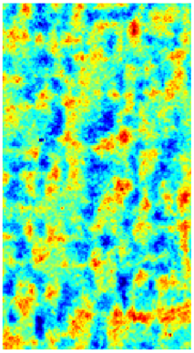
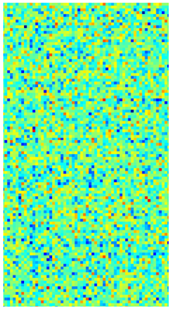
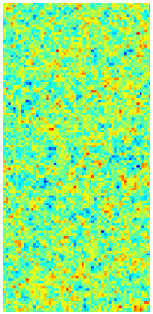
Intensified gated camera (4/7)
Correlated noise patterns
Image of static speckle pattern
sensor 1, seq. 1
sensor 1, seq. 2
Photron
SA5
SIM16
(same
techn.)

Slide 14
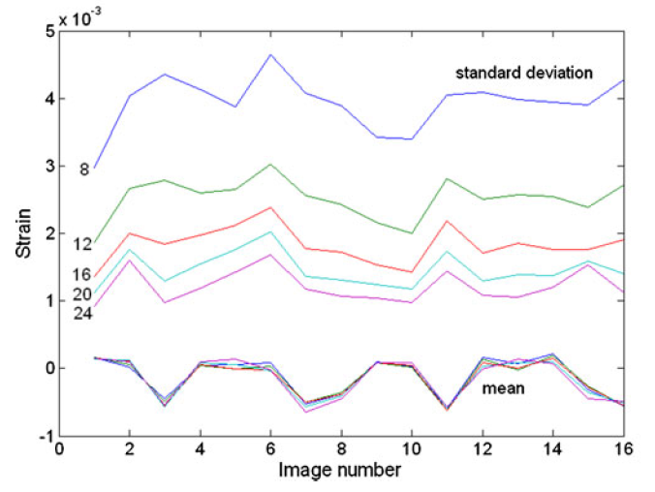
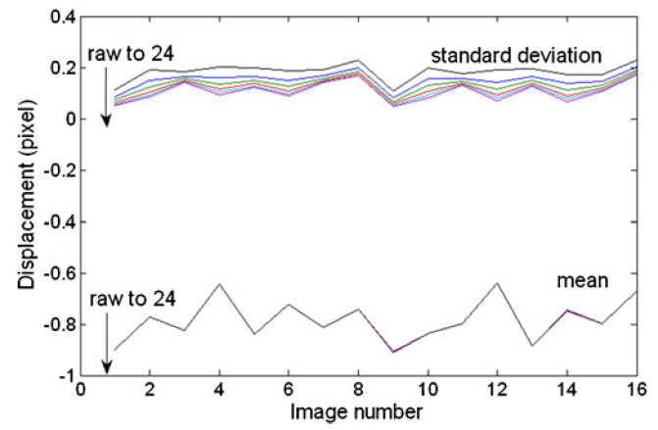
Intensified gated camera (5/7)
Resolution (31 pixels subset)
  Diffuse approximation smoothing

Slide 15
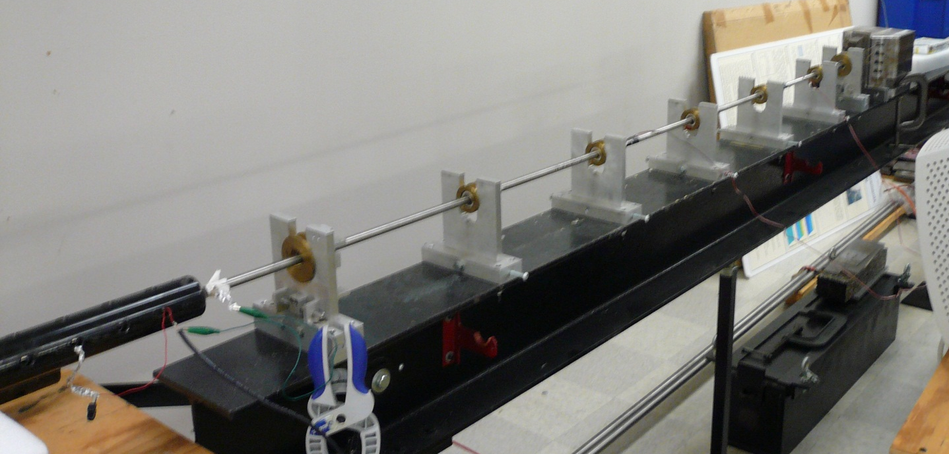
Intensified gated camera (6/7)
Pierron, Sutton, Tiwari
Experimental Mechanics, 2011

Slide 16
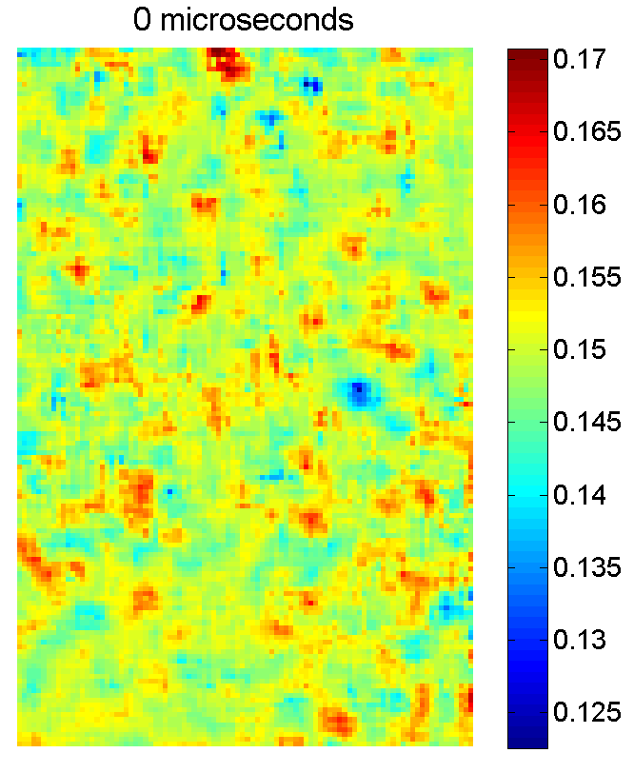
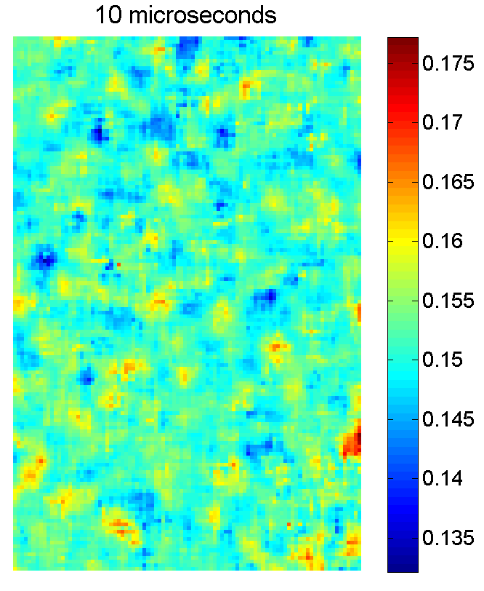
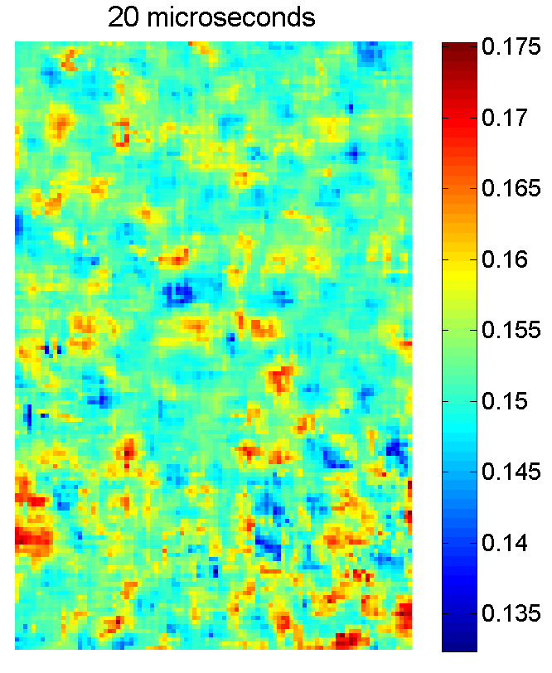
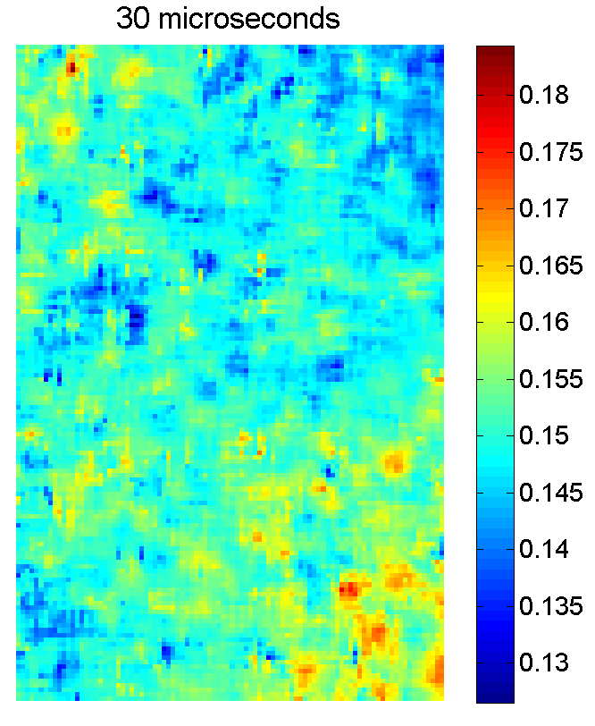
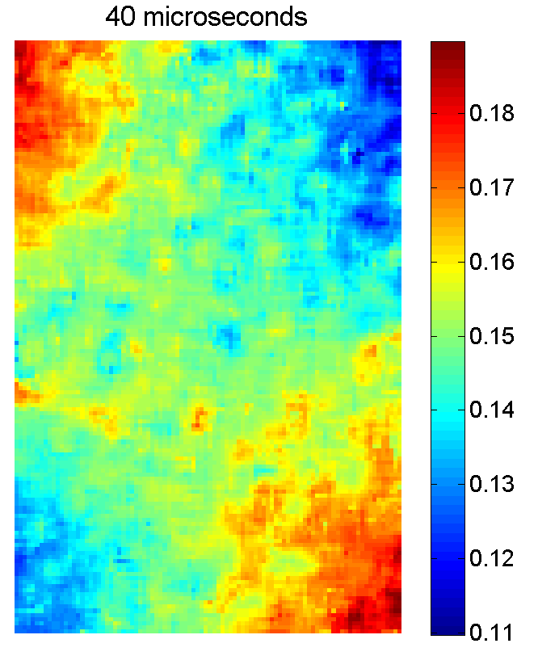
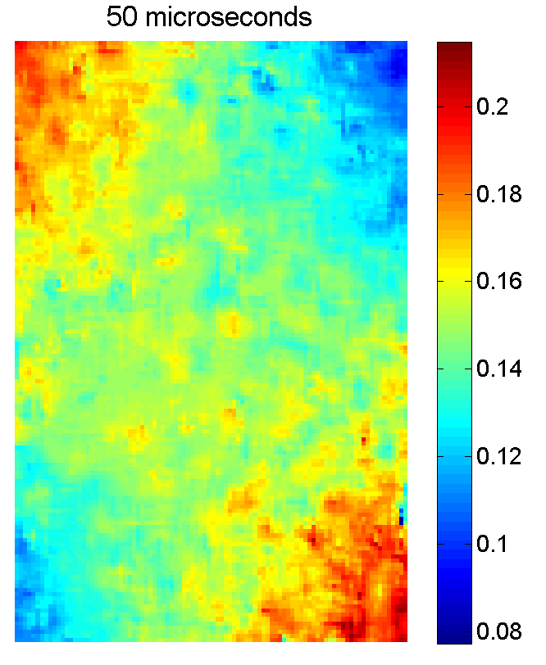
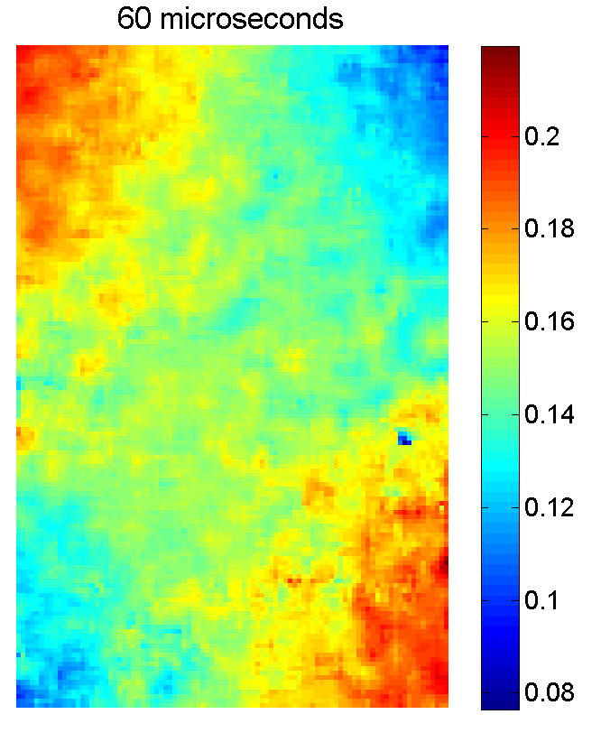
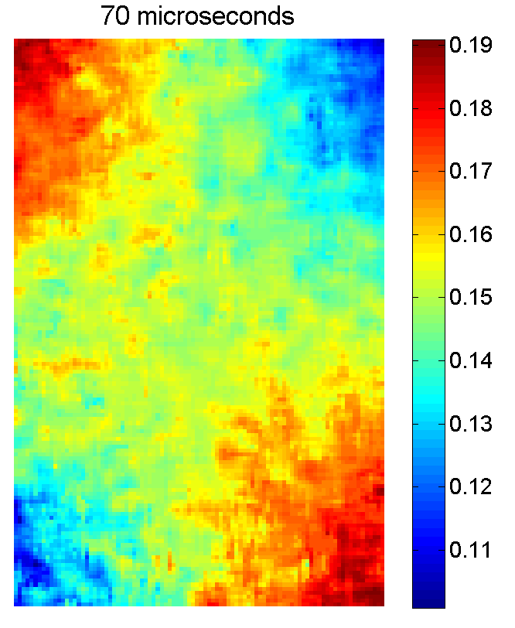
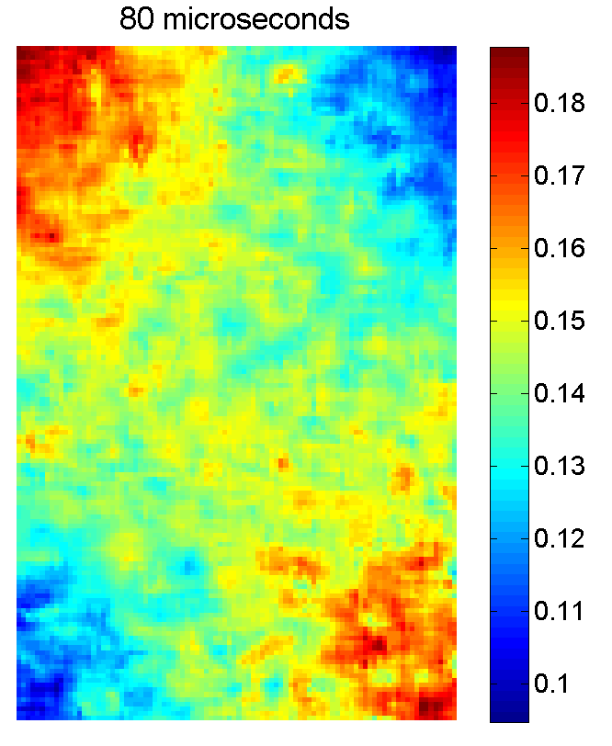
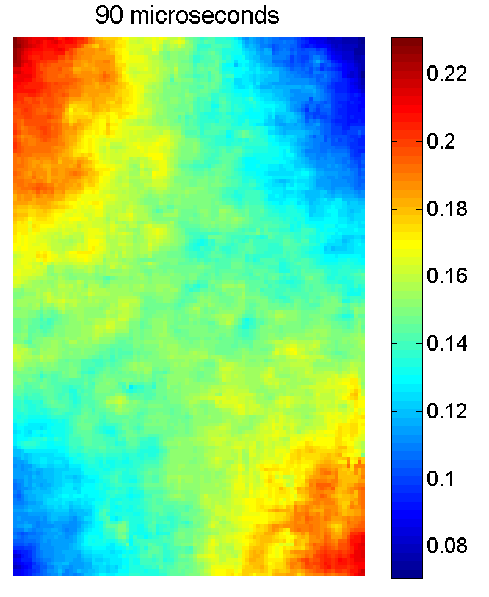
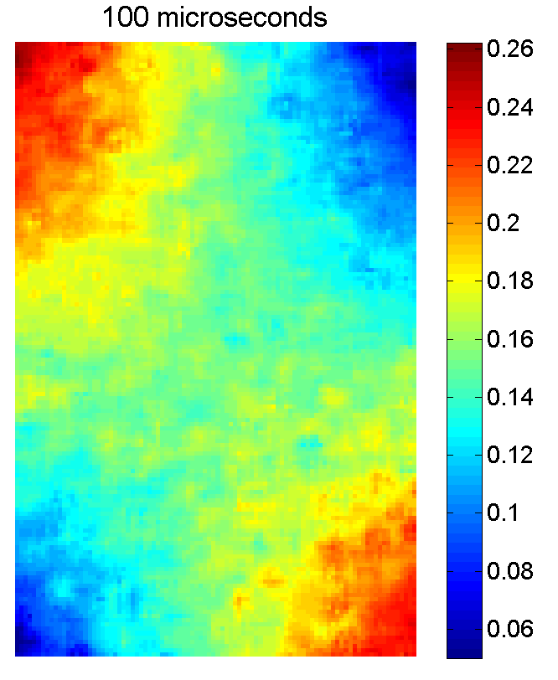
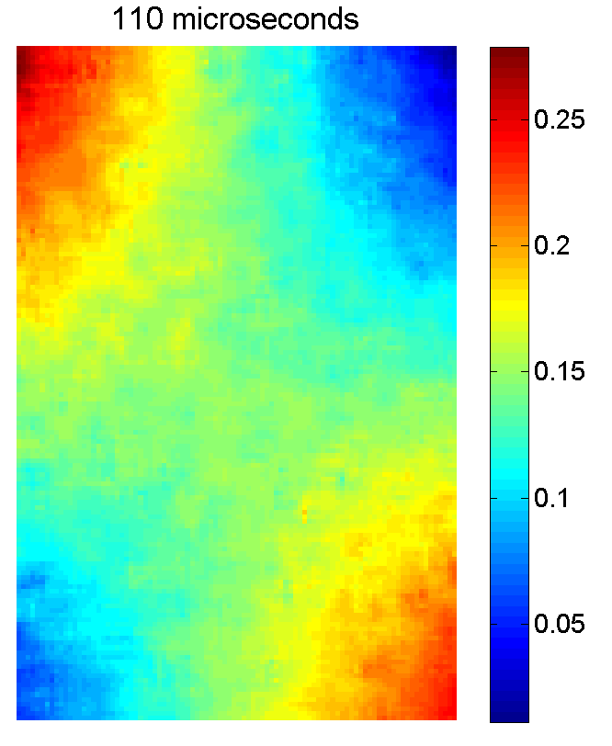
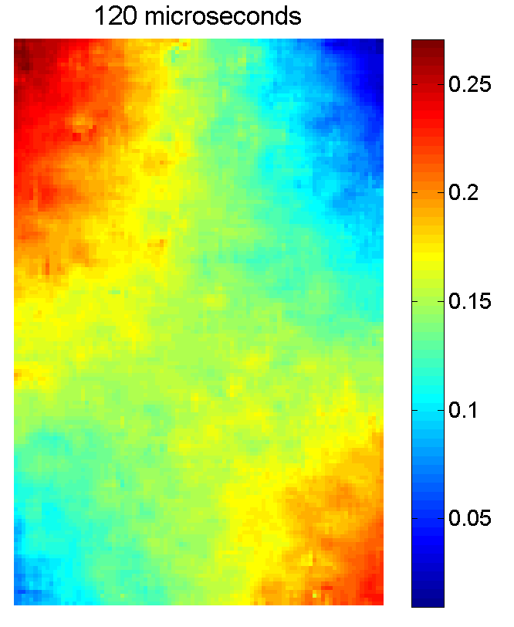
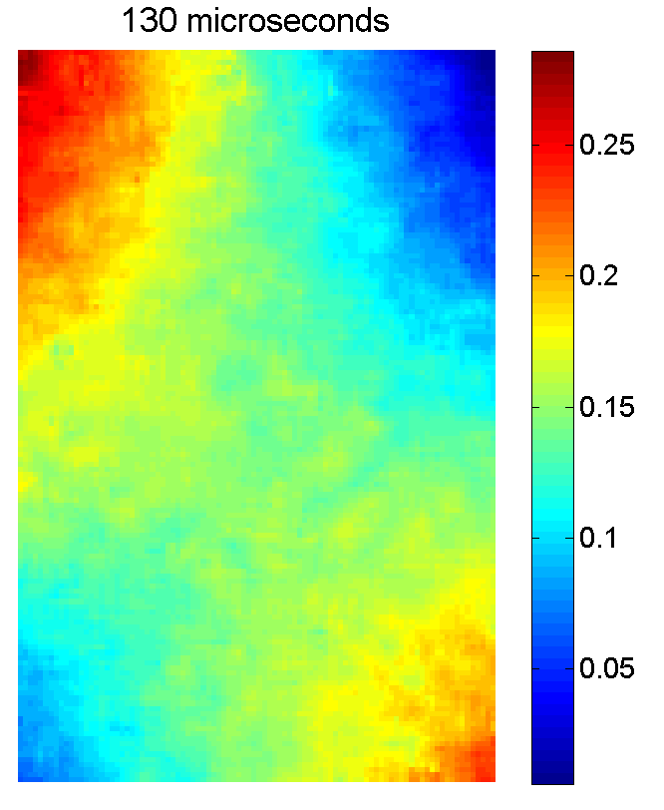
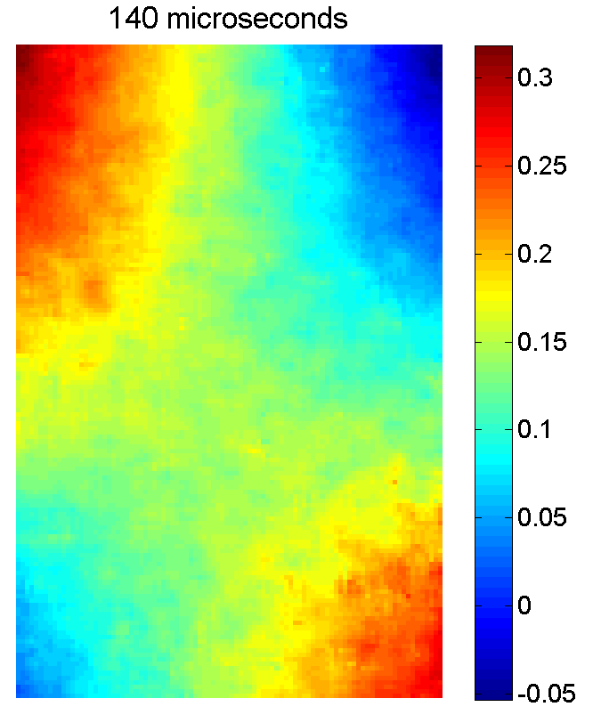
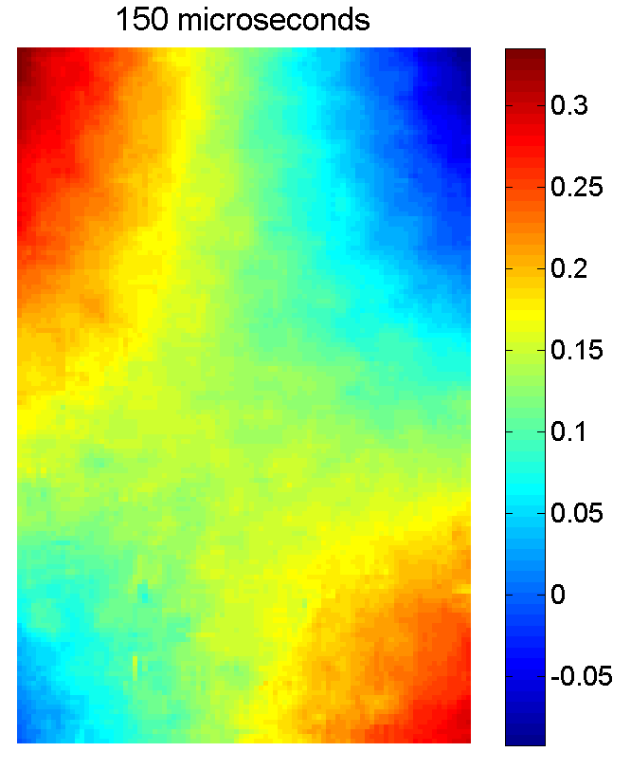
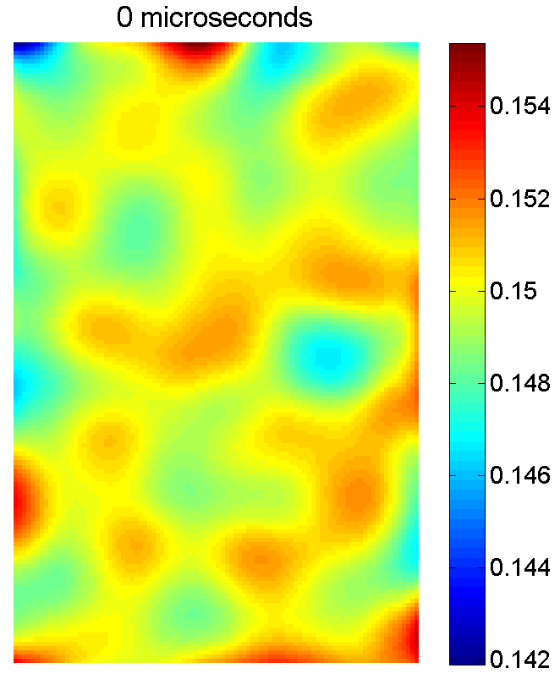
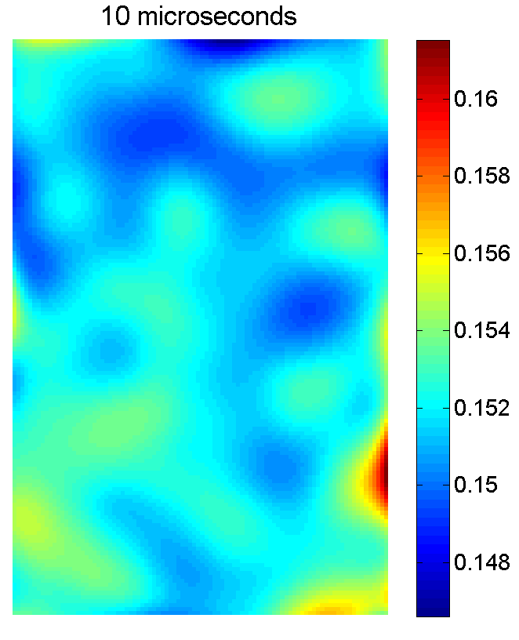
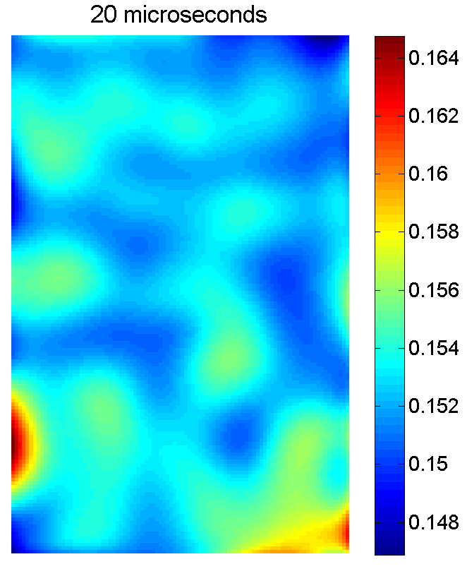
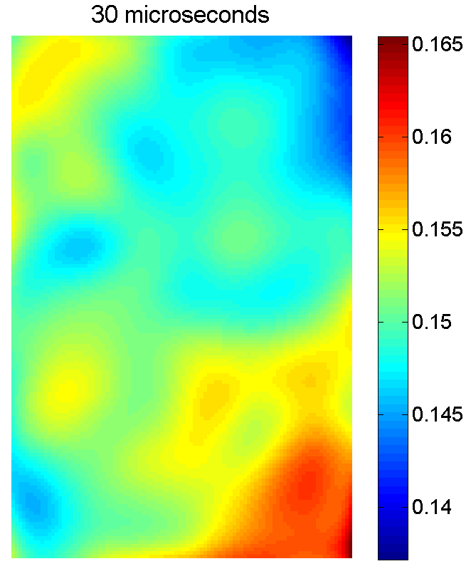
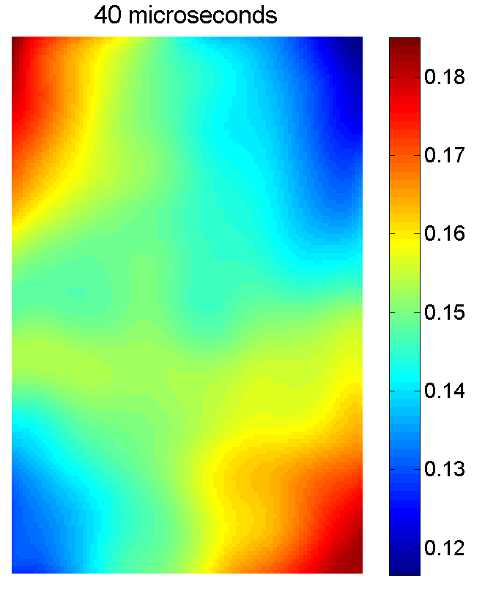
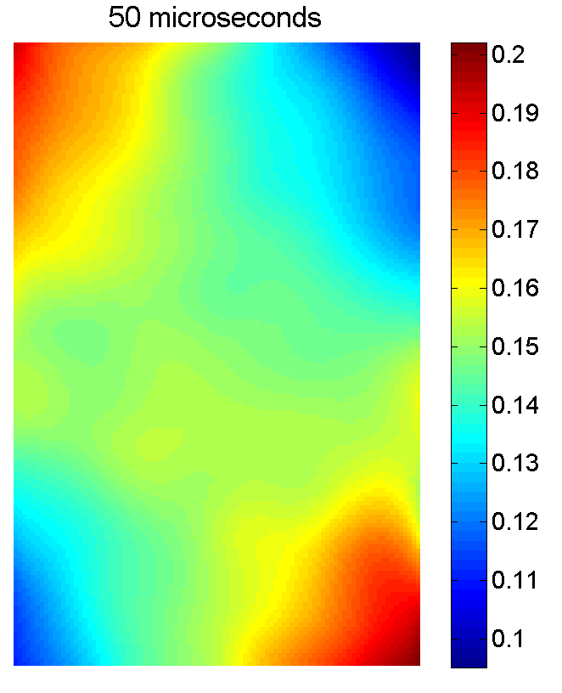










Intensified gated camera (7/7)
Displacement map: u_{y} in mm
Raw
DA Smoothed (R=24)
x
y

Slide 17

In-Situ Image Storage cameras (1/6)
In-Situ Image Storage (ISIS) or (IS-CCD) cameras
  Dedicated chip with on-board solid state memory
  Example: Shimadzu HPV2
    102 images at 2 Mfps
    312 by 260 pixels
    Very large pixel,
    small photogate
    Very low fill factor
    14% in x, 76% in y

Slide 18


In-Situ Image Storage cameras (2/6)
Effect of low fill factor
  Critical image distortion (very bad for strain measurements

Slide 19
In-Situ Image Storage cameras (3/6)
Effect of low fill factor
  Possible solutions: defocus image

Slide 20

In-Situ Image Storage cameras (4/6)
Specialized Imaging Ltd Kirana
  ‘CCD in CMOS’* sensor (on-board electron storage)
  924 x 768 pixels
  Pixel size: 30x30μm
  Fill factor: 40%
  180 images in a film
  5 Mfps
* Crooks, J., Marsh, B., Turchetta, R., Taylor, K., Chan, W., Lahav, A., & Fenigstein, A. (2013). Kirana: A solid-state megapixel uCMOS image sensor for ultrahigh speed imaging. Paper presented at the Proceedings of SPIE - The International Society for Optical Engineering.

Slide 21

In-Situ Image Storage cameras (5/6)
Shimadzu HPV-X
  FTCMOS* sensor (on-board electron storage)
  400 x 250 pixels
  Pixel size: 32x32μm
  Fill factor: 40%
  120 images in a film
  5 Mfps (10 Mfps at ½ image)
* Tochigi, Y., Hanzawa, K., Kato, Y., Kuroda, R., Mutoh, H., Hirose, R., . . . Sugawa, S. (2013). A global-shutter CMOS image sensor with readout speed of 1-tpixel/s burst and 780-mpixel/s continuous. IEEE Journal of Solid-State Circuits, 48(1), 329-338.

Slide 22




In-Situ Image Storage cameras (6/6)
Raw images
HPV-X
Kirana

Slide 23


Application (1/4)
Material: Tungsten Carbide
  13% Cobalt Binder, Fine Grain
Full-Field Measurement: Grid, 0.7mm, 5px/period
Contact Trigger
5mm
60mm
45mm
45mm
30mm
60mm
Specimen
WC
Waveguide
HS Steel
Oilon Sabot
Projectile
HS Steel 15CDV65
10 mm

Slide 24


Application (2/4)
Waveguide
Contact Trigger
Gas Gun Impact Rig
Projectile Speed: 40-45ms⁻¹
Specimen
Shimadzu HPV-X 400x250px 5Mfps
Barrel
Exit
Flash

Slide 25


Application (3/4)
Real Time: Mobile Phone
Shimadzu HPV-X: 5Mfps

Slide 26

Application (4/4)

Slide 27
Summary of performances
 | Temporal resolution | Strain resolution | Spatial resolution | Number of images | Ease of use
I-CCD cameras | ++++ | - | ++ | --- | +
Rotating mirror cameras | + | ++ | +++ | - | --
ISIS sensors HPV 1/2 | + | ++ | -- | + | +++
ISIS sensors HPV-X | ++ | +++ | - | ++ | +++
ISIS sensors Kirana | ++ | ++ | + | ++ | +++

