Slide 1
TSA Data Processing Guide
Dr. Richard Frühmann 08.04. 2011
Notes:
Please use the dd month yyyy format for the date for example 11 January 2008. The main title can be one or two lines long.

Slide 2
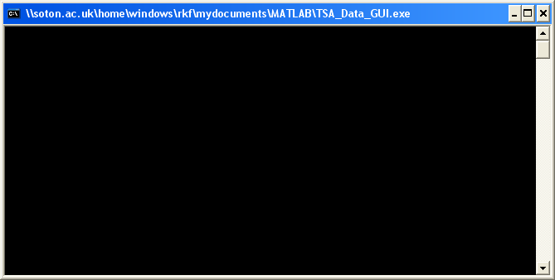
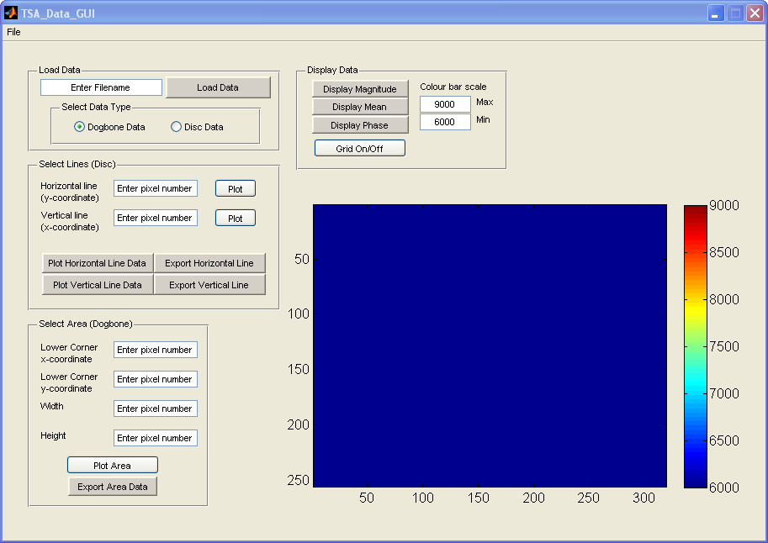
Start-up
2

Slide 3
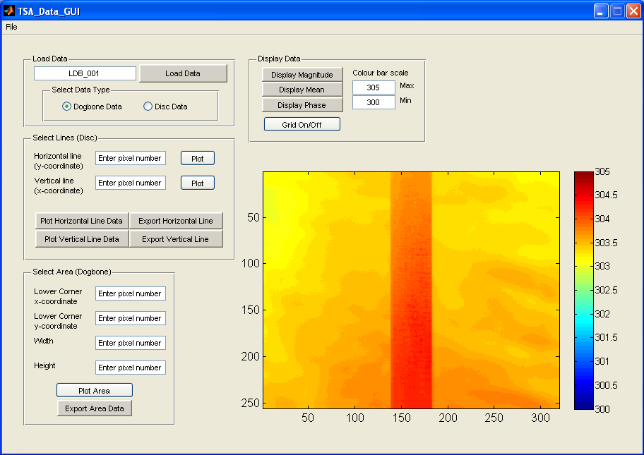
Load and Display Data
Click to load data
Enter the filename without extension
Select the colour scale
Choose data set to display
Select data type
(for calibration)

Slide 4
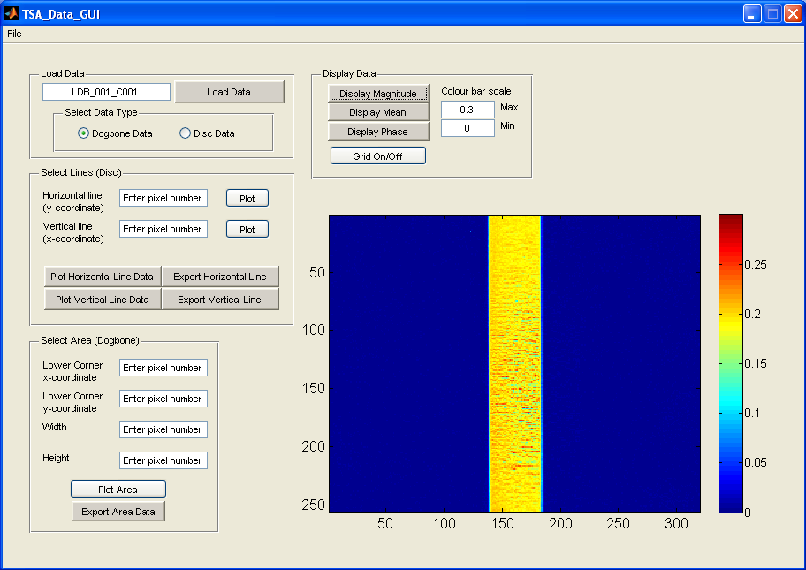
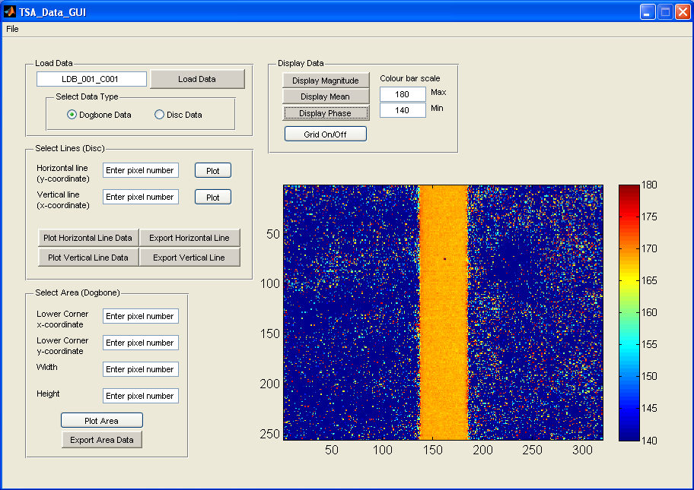
Load and Display Data

Slide 5
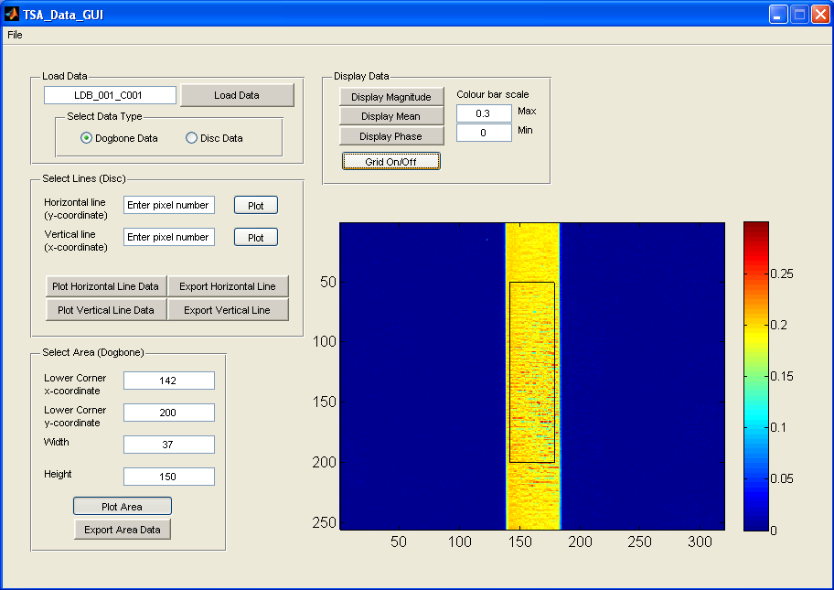
Extract Data (dog bone)
Define the area of data that you want to export
Default file name is “Area_data.txt”

Slide 6
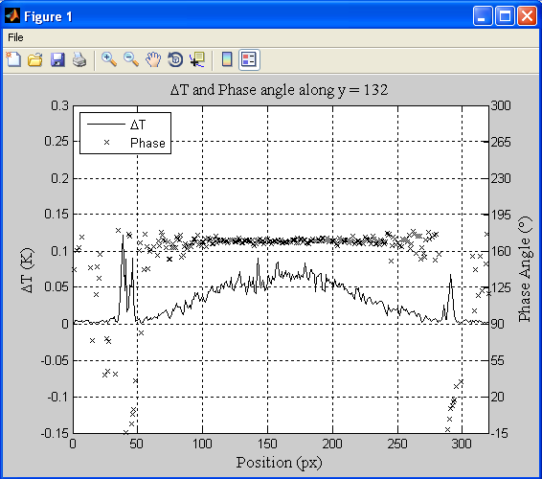
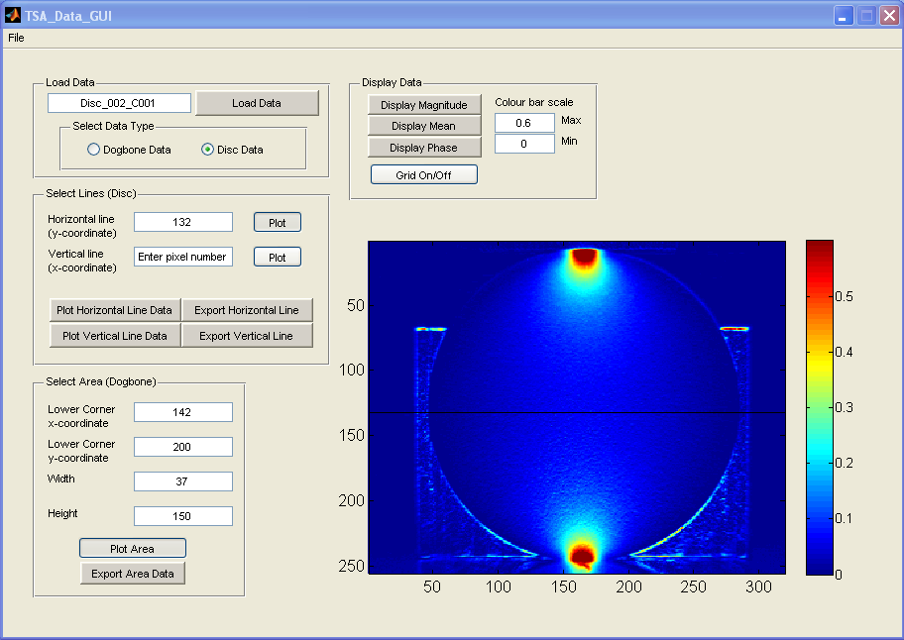
Extract Data (disc)
Define the position
of the line
Default filenames are “hline_data.txt” and “vline_data.txt”

