Slide 1
Thermoelastic stress analysis
Janice Dulieu-Barton
Notes:
Please use the dd month yyyy format for the date for example 11 January 2008. The main title can be one or two lines long.

Slide 2
Thermoelastic stress analysis
Aim:
  Overview
  Thermoelastic effect
  Derivation of thermoelastic relationships
  Detector type
  Calibration
  Assumptions
  Examples

Slide 3

Rastogi, Pramod / Hack, Erwin (eds.)
Optical Methods for Solid Mechanics
A Full-Field Approach
8 Thermoelastic Stress Analysis 345
Janice M. Dulieu-Barton
8.1 Introduction 345
8.2 The Thermoelastic Effect 345
8.3 Infrared Thermography 348
8.4 Obtaining Thermoelastic Measurements from an Infrared
System 352
8.5 Temperature Dependence of Thermoelastic Response 354
8.6 Derivation of the Thermoelastic Constant 354
8.7 Nonadiabatic Conditions 356
8.8 Paint Coatings 358
8.9 Temperature Dependence of the Material Elastic Properties 359
8.10 Progress, Applications, and Prospects 363
Acknowledgements 365

Slide 4
Thermoelastic stress analysis

Slide 5
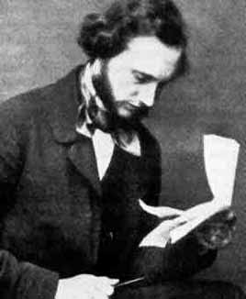
Thermomechanical coupling
William Thomson – Lord Kelvin 26 June 1824 – 17 December 1907
Mathematician, Physicist and Engineer
Thermodynamics – ca 1850

Slide 6
Thermoelastic effect
Assume the temperature change is isentropic
for i, j = 1, 2, 3

Slide 7
Stress-strain temperature equations
Neglecting temperature derivatives of the material elastic properties

Slide 8
Thermoelastic equation
is the rate of change of the sum of the first stress invariant (σ₁₁+ σ₂₂+ σ₃₃)

Slide 9
Infra-red systems

Slide 10
Temperature dependence
N_{b} ∝ T^{n}
B = 6.322 x 10⁶ photons s⁻¹ m⁻³ sr⁻¹ K^{-10.47} and n = 10.47; the correlation coefficient for the curve fit was 0.99. Therefore a temperature correction factor can be introduced as

Slide 11
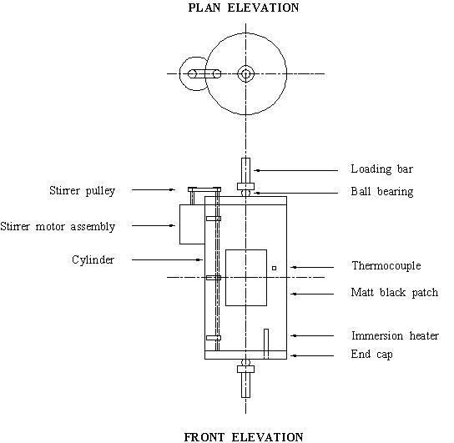
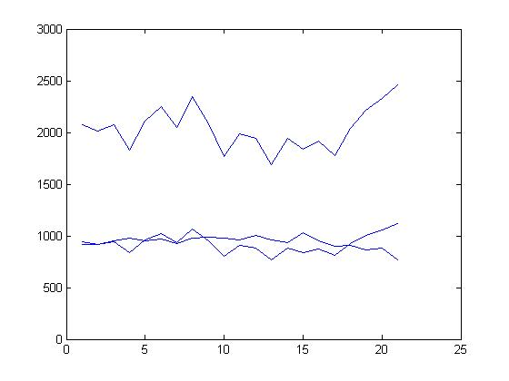
Correction factor
Dulieu-Barton, J.M., Emery, T., Cunningham, P.R. and Quinn, S., “A temperature correction methodology for quantitative thermoelastic stress analysis and damage assessment”, Measurement Science and Technology, 2006, 17, pp 1627-1637.

Slide 12
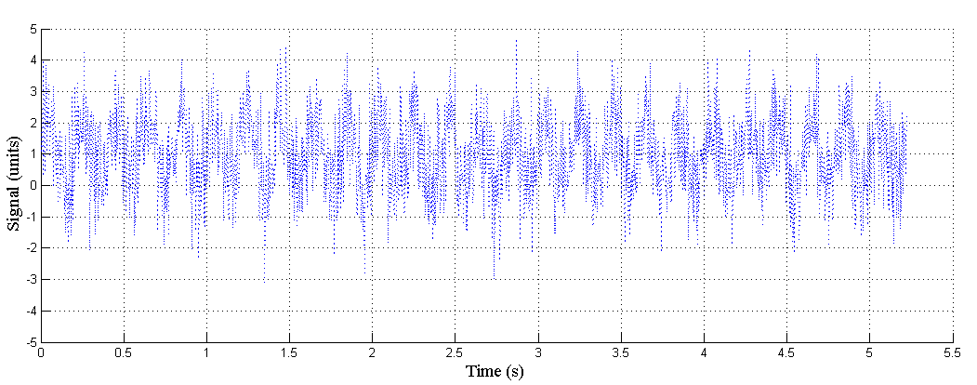
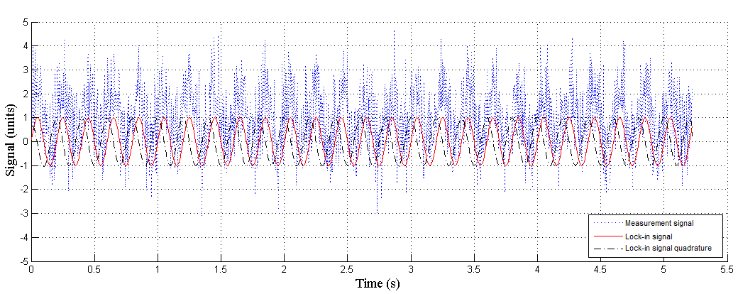
Lock-in processing- the necessity for cyclic loading
Example of a typical noisy measurement signal in TSA.
  Noise and signal are of similar amplitude.
A reference signal is obtained that contains only the frequency of interest.
  The reference signal is split into a sine and cosine part.

Slide 13
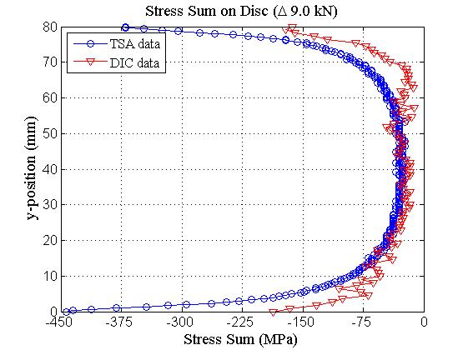
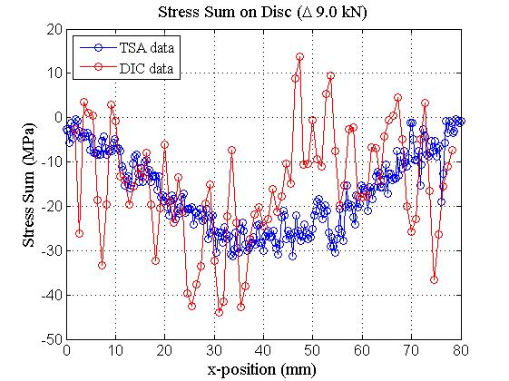
Brazilian Disc – comparison of DIC and TSA

Slide 14
Lock-in DIC
Visual comparison between static and dynamic results.
Static
0.75 Hz
7.1 Hz
21.1 Hz
Fruehmann, R.K., Dulieu-Barton, J.M., Quinn, S., and Tyler, J.P., “Digital image correlation applied to cyclically loaded components,” Optics and Lasers in Engineering. 2015.

Slide 15
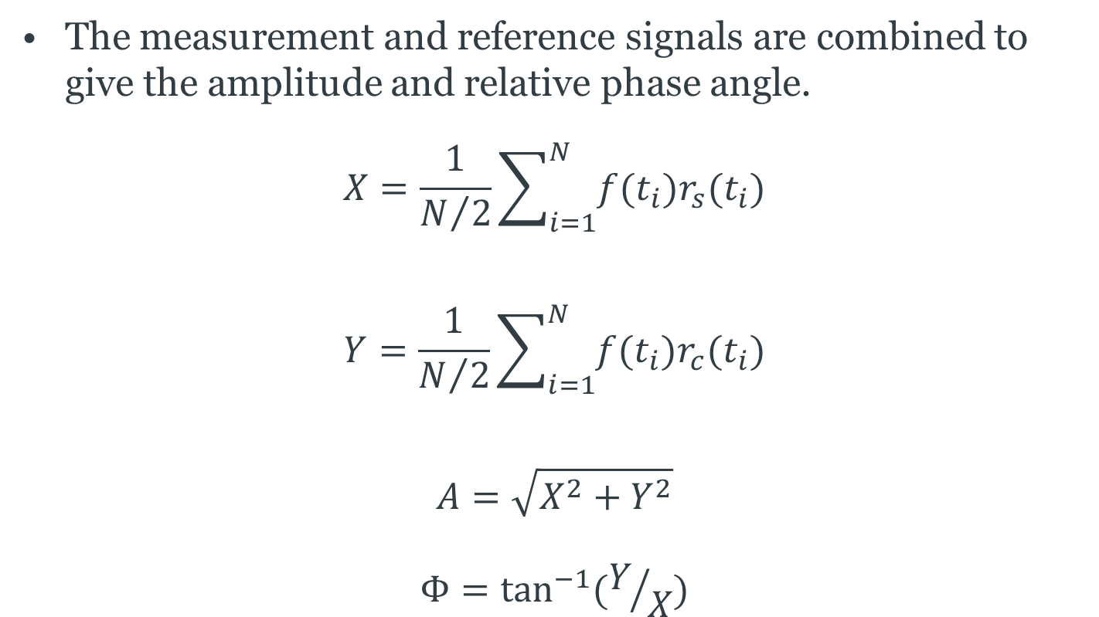
Lock-in processing
The measurement and reference signals are combined to give the amplitude and relative phase angle.
$$X=\frac{1}{N/2}\sum_{i=1}^{N}{f(t_{i})r_{s}(t_{i})}$$
$$Y=\frac{1}{N/2}\sum_{i=1}^{N}{f(t_{i})r_{c}(t_{i})}$$
$$A=\sqrt{X^{2}+Y^{2}}$$
$$Φ=\tan^{−1}⁡(Y/X)$$
Measurement signal
Reference signal sine and cosine parts

Slide 16
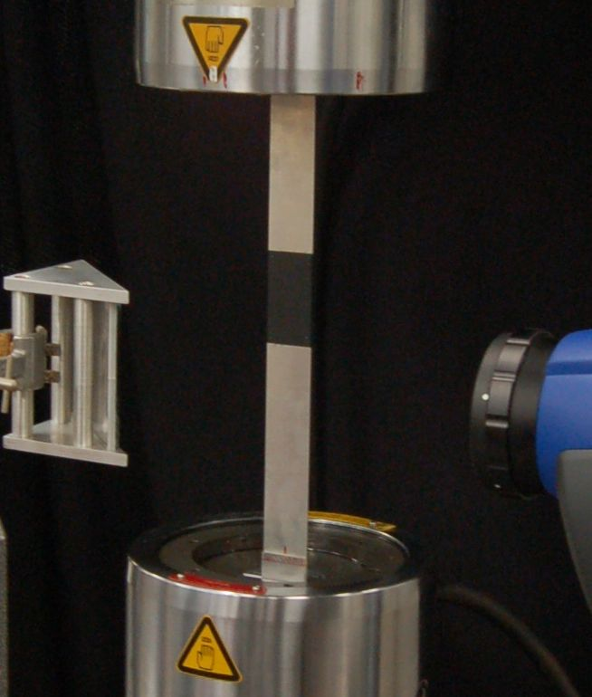
Derivation of the thermoelastic constant
Direct calibration, using properties of the infrared detector, system variables, specimen surface emissivity and the thermoelastic constant of the specimen material.
Calibration against measured stress
Calibration against calculated stress
Dulieu-Smith, J.M., "Alternative calibration techniques for quantitative thermoelastic stress analysis", Strain, 1995, 31, pp 9-16.

Slide 17
Othotropic materials - calibration
Stresses
TSA
FEA
Emery, T.R., Dulieu-Barton, J.M., Earl, J.S. and Cunningham, P.R., “A generalised approach to the calibration of orthotropic materials for thermoelastic stress analysis”, Composites Science and Technology, 2008, 68, 743-752.

Slide 18
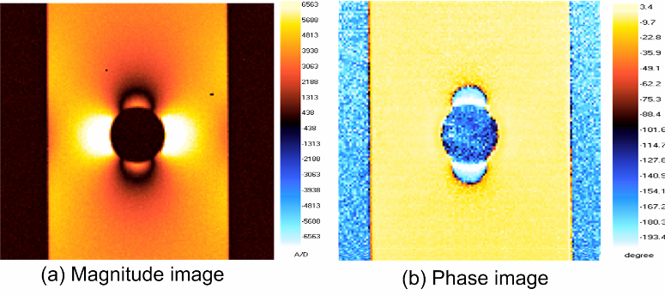
Non adiabatic behaviour

Slide 19
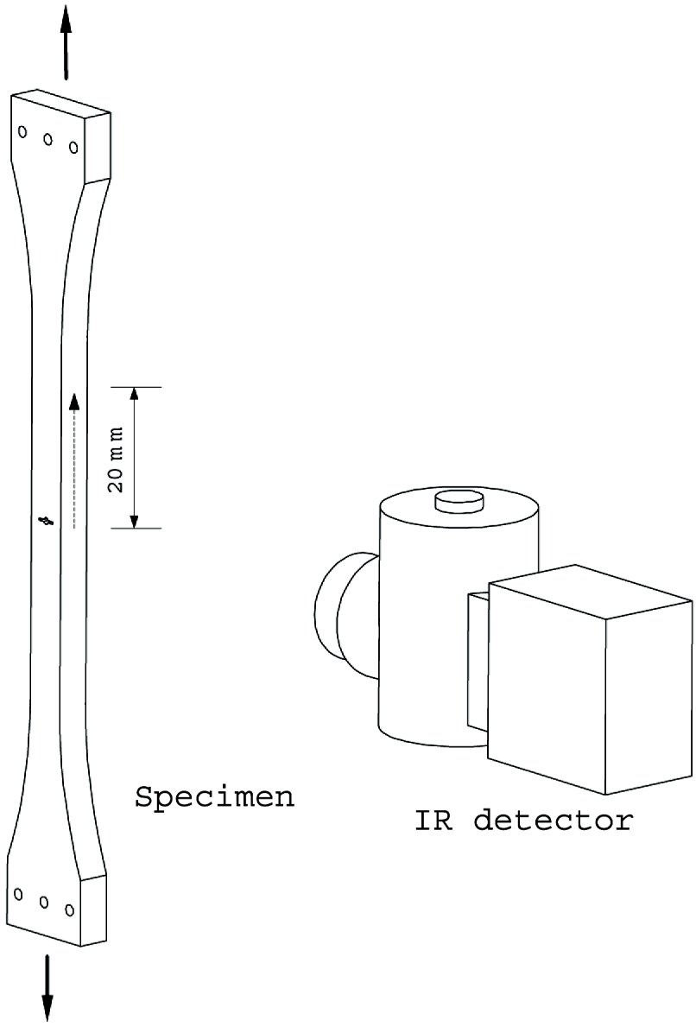
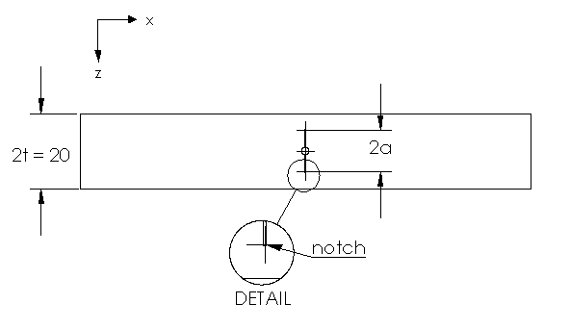
Specimens with sub-surface damage
Materials
Aluminium alloy
Steel
PMMA

Slide 20
Magnitude and Phase results
Sathon, N. and Dulieu-Barton, J.M. “Evaluation of sub-surface stresses using thermoelastic stress analysis”, Applied Mechanics and Materials, 2007, 7-8, pp 153-158.

Slide 21
Paint coating
It is standard practice when taking thermographic measurements to coat the specimen surface with a thin layer of matt black paint to improve emissivity and ensure the response is uniform.
Two short passes of paint supplied using an aerosol is deemed suitable for most applications.
Coating is thermally inert in comparison with the specimen and may in certain instances give rise to non-adiabatic effects.
Thermal lag is caused by the insulating effect of the paint coating.
An increase in paint coating thickness will result in a smaller ∆T at the paint surface than at the substrate surface.
Thermal drag-down relate to both the paint thickness and the loading frequency.
No heat is being generated by the coating, temperature can only change due to the heat transferred to it from the substrate.
As the loading frequency increases, the spatial wavelength decreases; as a result there is less heat input into the coating.

Slide 22
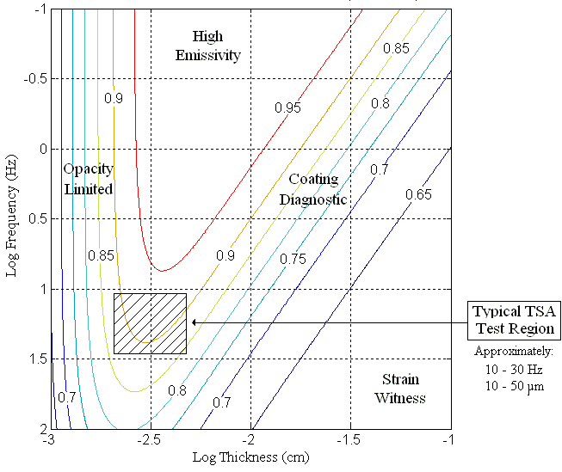
Paint response

Slide 23
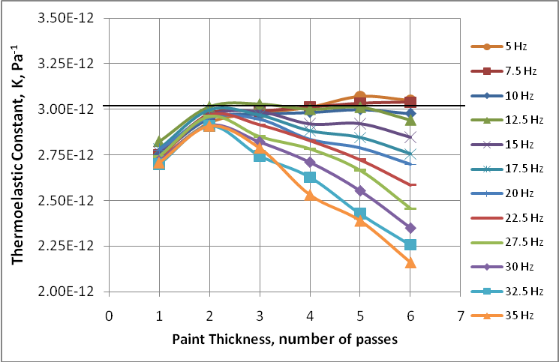
Surface preparation

Slide 24
Experimental verification
Robinson, A.F., Dulieu-Barton, J.M., Quinn, S. and Burguete R.L., “Paint coating characterisation for thermoelastic stress analysis” Measurement Science and Technology, 2010, 21, 085502, 11 pages. http://dx.doi.org/10.1088/0957-0233/21/8/085502.

Slide 25
Temperature dependence of material elastic properties
E =

Slide 26
Material properties

Slide 27

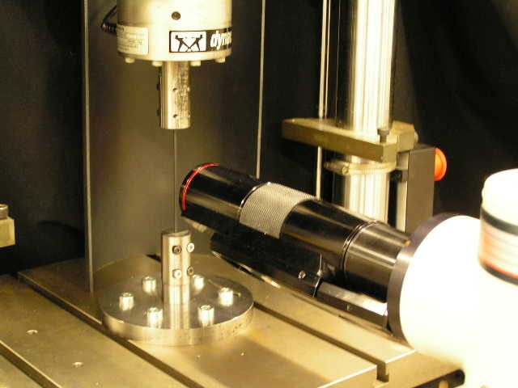
Experiment setup
Tube in tension
Nitinol tubes used for characterisation:
  OD = 3.0 mm
  ID = 2.5 mm
Loaded in simple tension
Detector

Slide 28
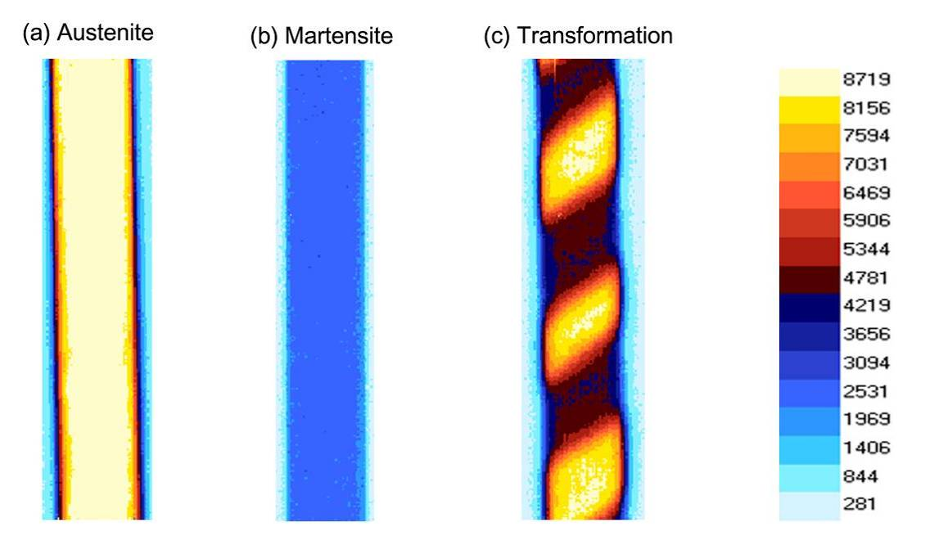
General response

Slide 29
Signal vs. applied stress
Δσ : increased
σ_{m}: const.
Freq: const.

Slide 30
Mean stress dependence
Mean stress

Slide 31
Variation of Young’s modulus with temperature
Material | (MPa/K)
Ti-6Al-4V¹ | -48.0
Al-2024¹ | -36.0
4340 steel¹ | -56.7
Stainless steel | -19.0
NiTi (austenite) | 2230.0

Slide 32
Mean stress dependence
Δσ : const.
σ_{m}: increased
Freq: const
Eaton-Evans, J., Dulieu-Barton, J.M., Little, E. and Brown, I., “Thermoelastic studies on Nitinol stents”, Journal of Strain Analysis for Engineering Design, 2006, 41, pp 481-495.

Slide 33
TSA at elevated temperatures
0
^{dE}/_{dT}

Slide 34
Temperature controlled test chamber

Slide 35
Mean stress dependence at elevated temperatures
Δσ: const
σ_{m}: increased
Freq: const

Slide 36
Mean stress effect
    A change in the mean cyclic stress causes a small change in ∆T
    Aluminium alloy specimens under same load amplitude, but over a range of mean stress levels
Material | E | dE/dT
 | (MPa) | MPa/ºC
AA2024 | 74000 | -53.3
AA7085 | 69000 | -48.5
Robinson, A.F., Dulieu-Barton, J.M., Quinn, S. and Burguete R.L., “The potential for assessing residual stress using thermoelastic stress analysis: a study of cold expanded holes”, Experimental Mechanics, 2013, 53, 299-317. DOI 10.1007/s11340-012-9633-1

Slide 37
Stresses in secondary aircraft structure
Increased use of composite materials in aircraft structure
  weight saving
  improved life time
Development of new manufacturing techniques and new materials
Crump, D.A., Dulieu-Barton, J.M. and Savage, J., “The manufacturing procedure for aerospace secondary sandwich structure panels” Journal of Sandwich Structures and Materials, 2010, DOI :10.1177/1099636209104531

Slide 38
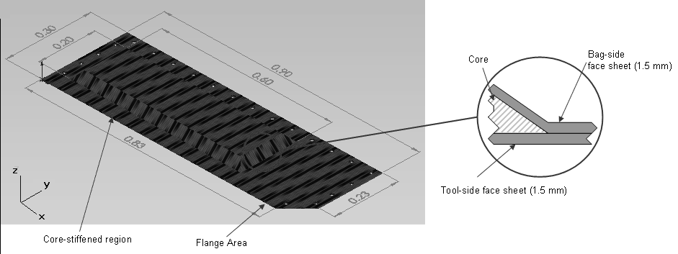
Generic panel
38

Slide 39
Face sheet material characterisation
UD prepreg/autoclaved
NCF RFI Oven cure

Slide 40
Thermoelastic constants

Slide 41
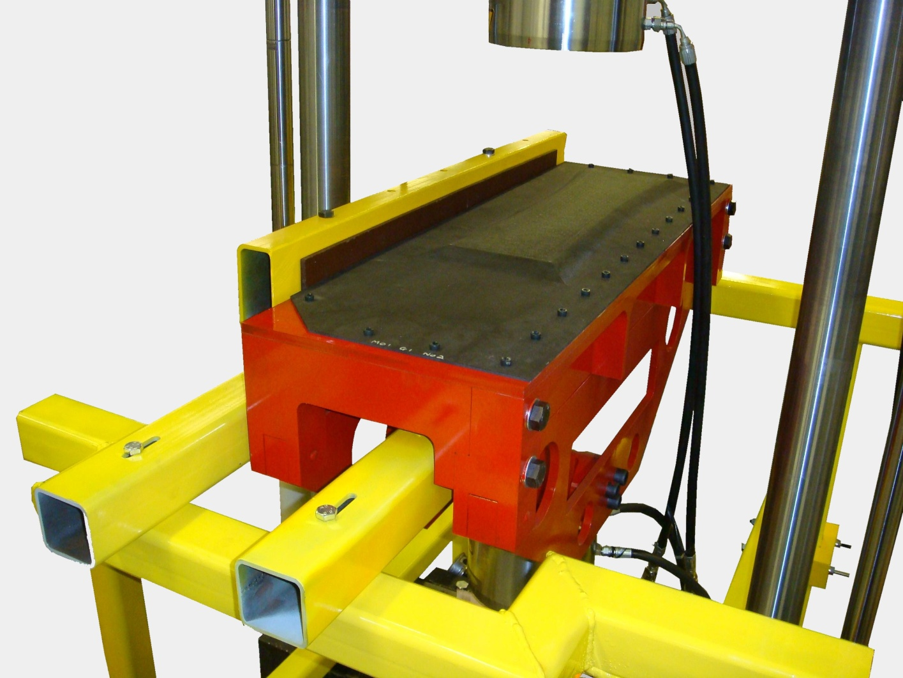
Full-scale tests
Panels cyclically loaded at 1 Hz on custom design rig to allow a pressure load – imparting 10 ± 5 kPa
Generic Panel
Water filled cushion
Unloaded
Loading Section
Supported Plate
Crump, D.A., Dulieu-Barton, J.M. and Savage, J., “Design and commission of an experimental test rig to apply a full-scale pressure load on composite sandwich panels representative of aircraft secondary structure”, Measurement Science and Technology, 2010, 21, (16pp). DOI: 1088/0957-0233/21/1/015108
Loaded

Slide 42
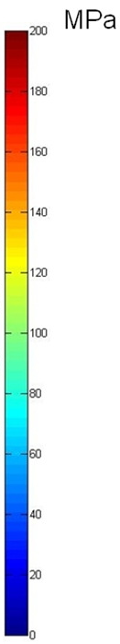
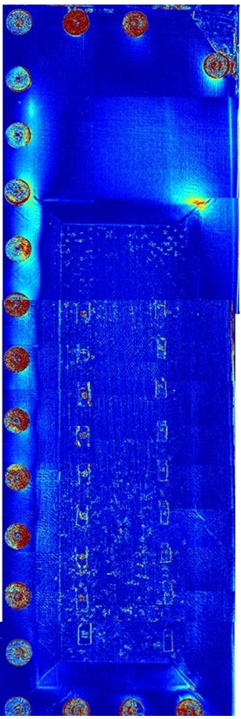
Results
Autoclaved
RFI, NCF
Standard autoclaved prepreg offered a panel with a maximum deflection of 6.3 mm whilst RFI, NCF panel deformed by 4.6 mm.
The measured stress response indicated a reduction in stress peak when using RFI and NCF.

Slide 43
Comparison of TSA and FEA

Slide 44
Autoclaved

Slide 45
NCF -RFI

Slide 46
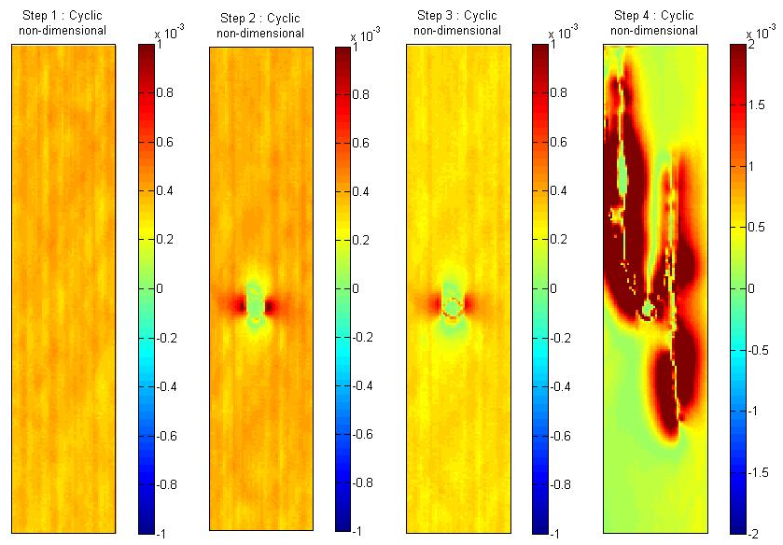
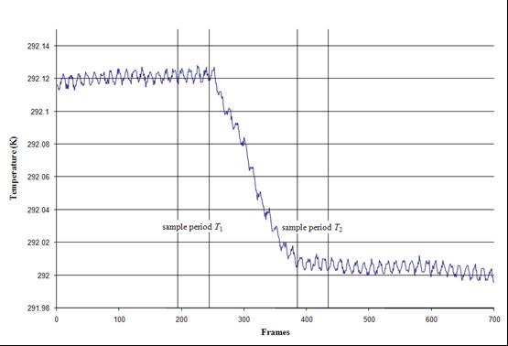
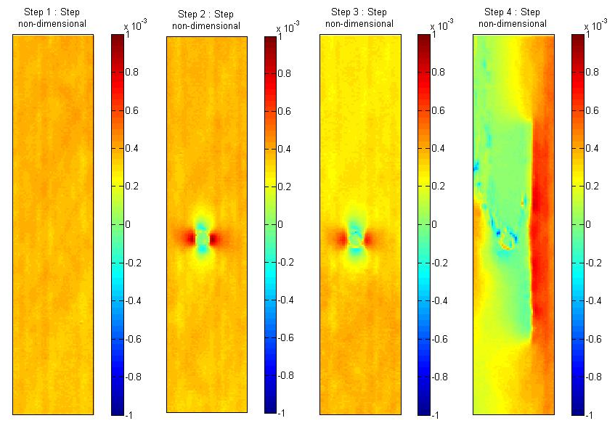
Is a test machine required?
Frühmann, R.K., Dulieu-Barton, J.M. and Quinn, S., “Thermoelastic stress and damage analysis using transient loading” Experimental Mechanics, 2010. DOI: 10.1007/s11340-009-9295-9

Slide 47
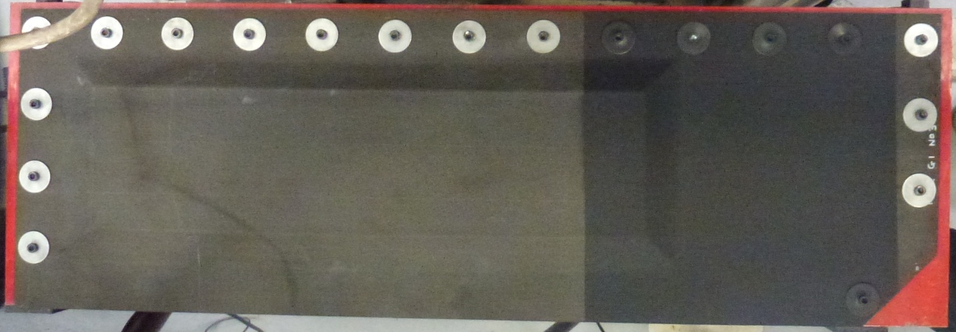
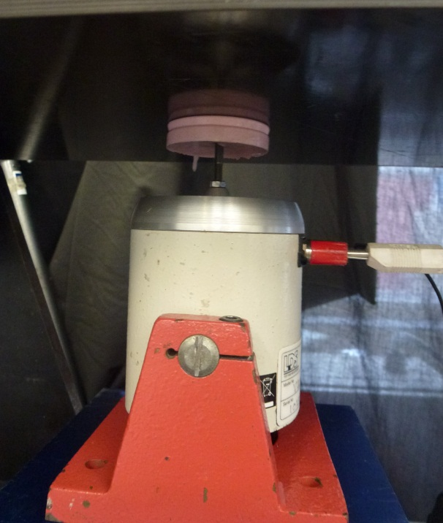
Full-scale inspection
TSA measurement of full-scale secondary aircraft panel with incremental damage.
Data from natural frequency loading
Data from forced loading

Slide 48
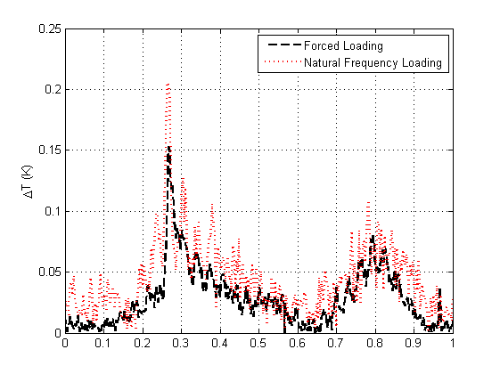
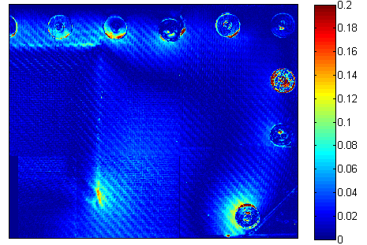
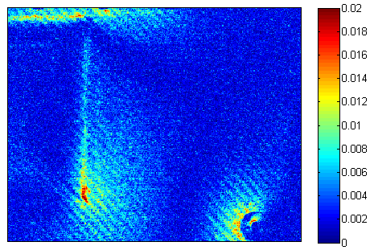
Full-scale inspection
Forced loading data
Natural frequency loading data

Slide 49

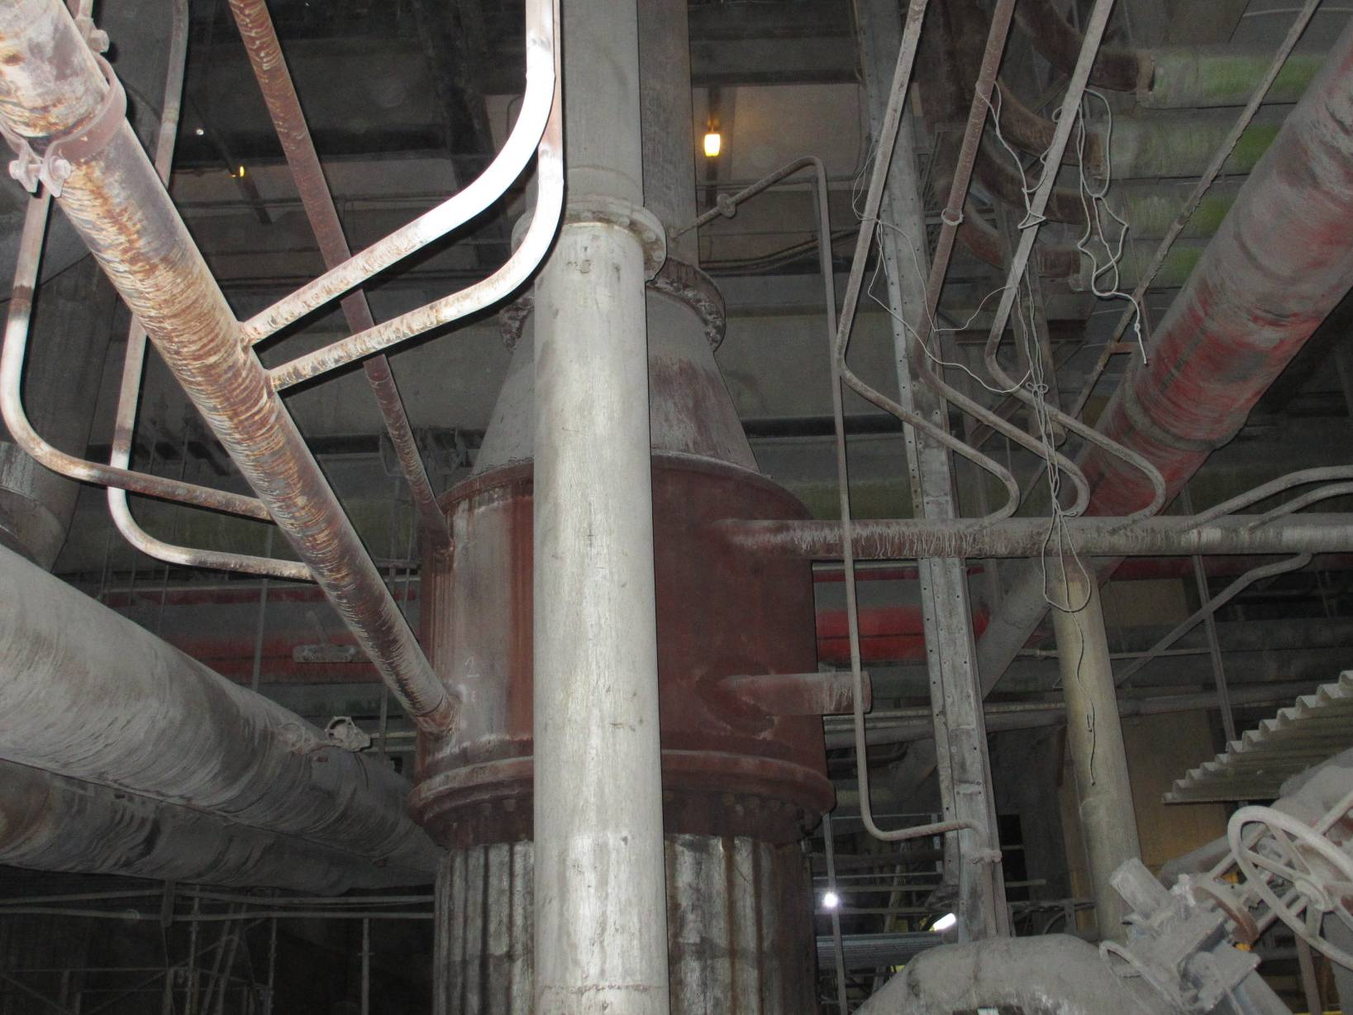

On-site steam pipe inspections at EDF West Burton coal fired power station
Pipes 3-5
Pipes 1-2

Slide 50
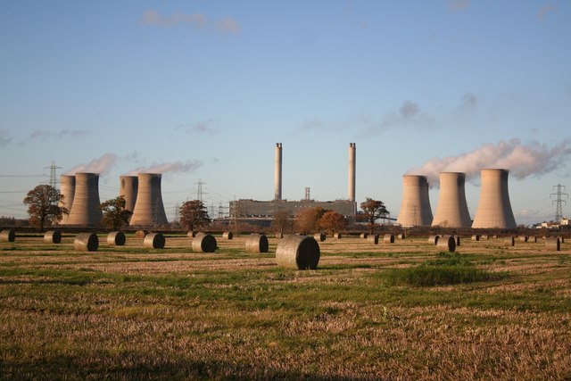

West Burton, north Nottinghamshire, UK
Commissioned 1968
2 x 900 MW
Turbine hall 260 m long, 40 m wide and 26 m high
Smoke stack = 200 m
Raises steam at 159 bar to power the HP turbines

Slide 51
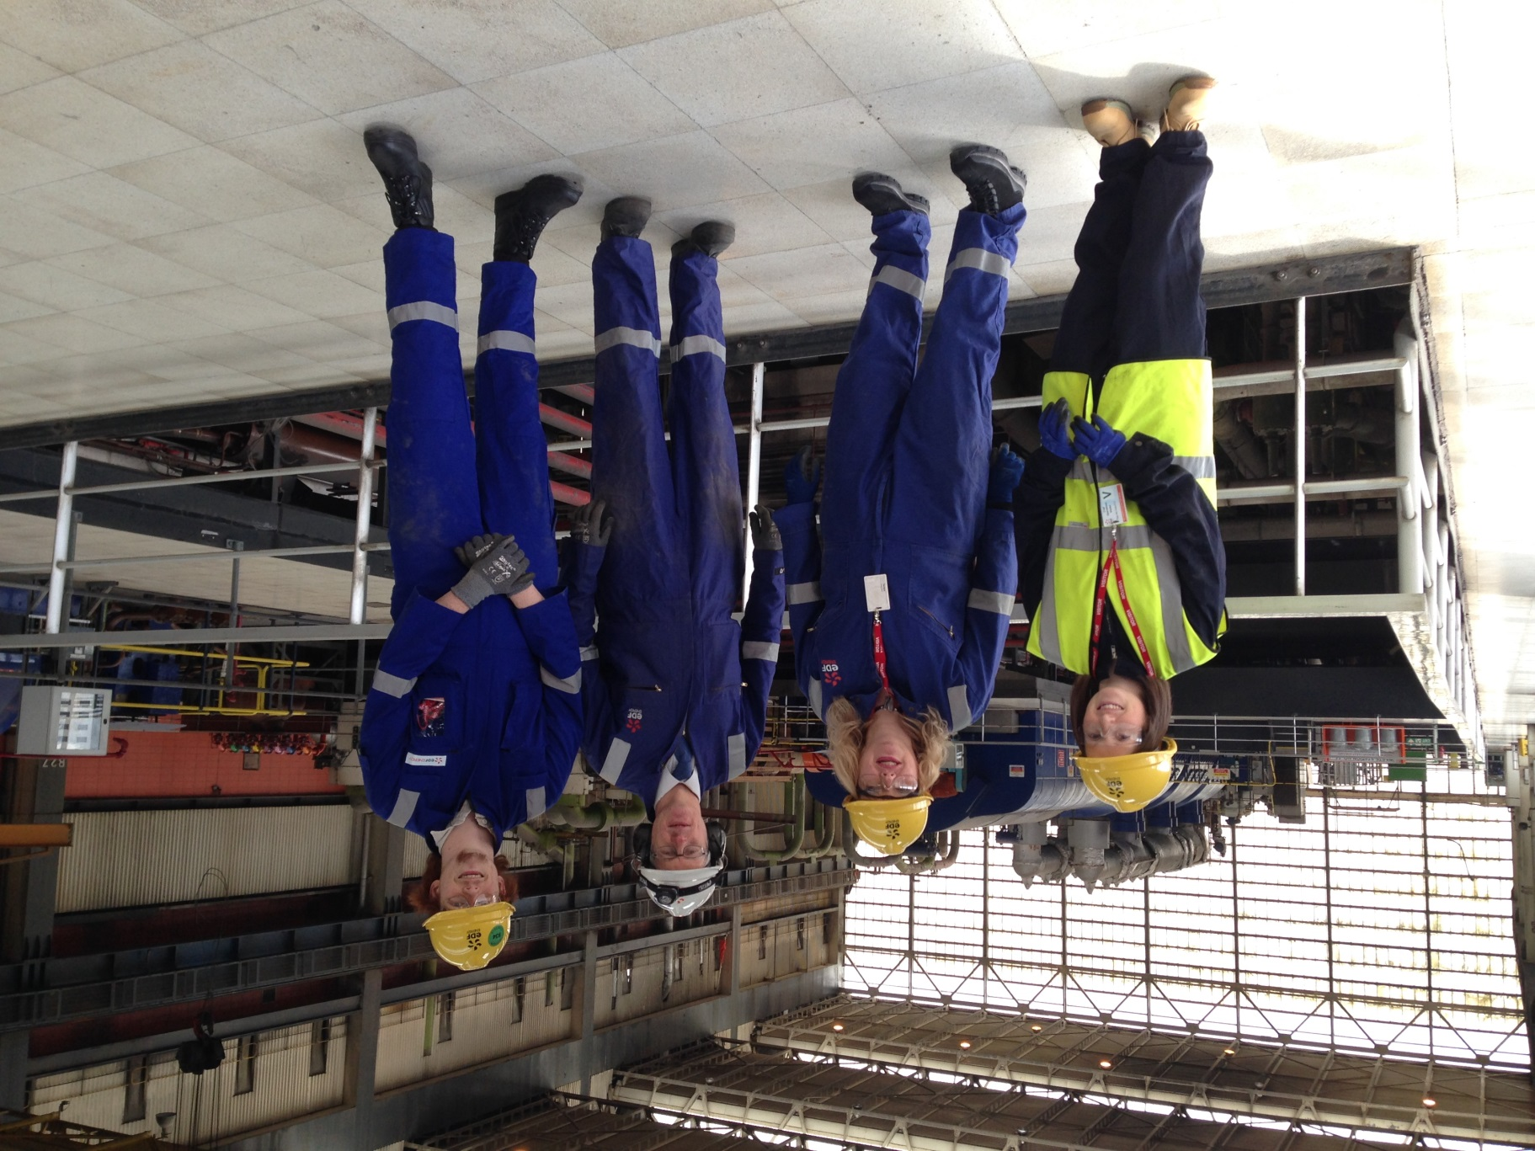

Slide 52
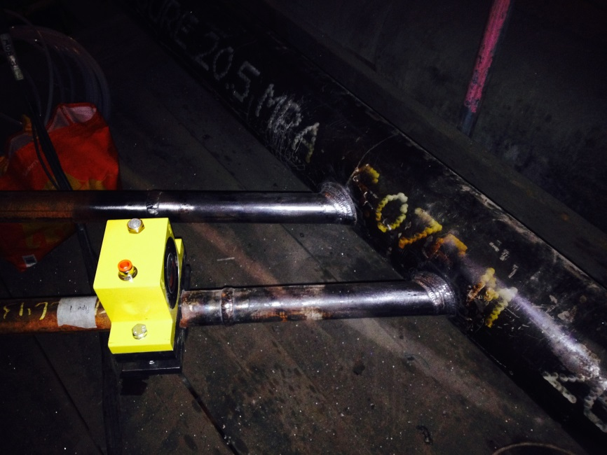
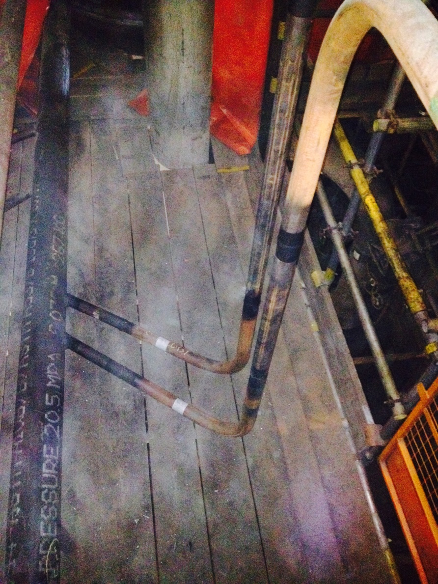
Pipe 1 inspection
1.4
1.1
1.3
1.2
All surfaces were prepared using 80 grit SiC paper and painted with matt black spray paint.
The pneumatic shaker was positioned at the midpoint of the horizontal section and remained in the same position for all pipe 1 weld inspections.
Shaker location

Slide 53
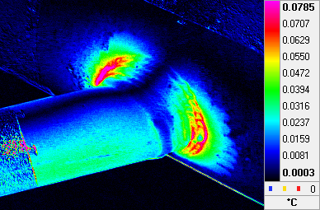
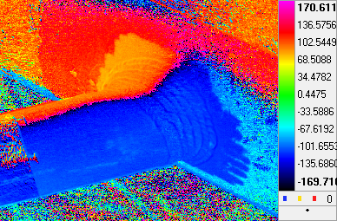
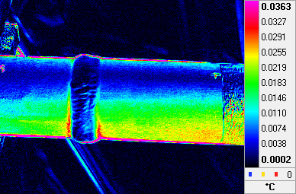
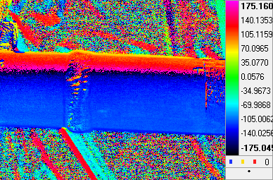
Pipe 1 results
ΔT
Phase
Weld 1.1
Weld 1.2

Slide 54
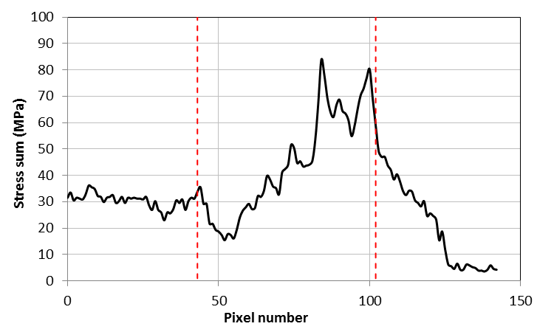
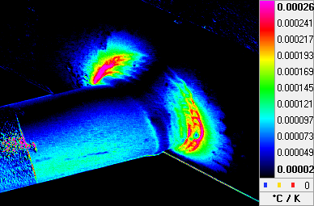
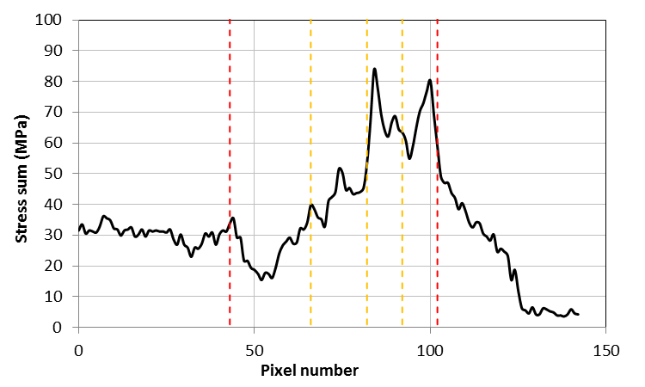
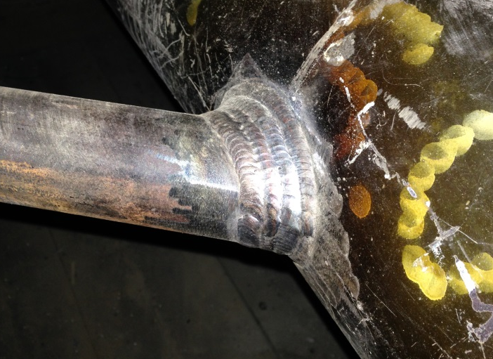
Stresses
Weld 1.1
Max stress sum that the pipe is experiencing is found at weld 1.1 where the pipe joins a larger section of pipe.
Maximum stress sum is around 85 MPa.
Weld features are highlighted in the stress sum data.
R.C. Tighe, G.P. Howell, J.P. Tyler, S. Lormor, J.M. Dulieu-Barton
Stress based non-destructive evaluation using thermographic approaches: From laboratory trials to on-site assessment NDT & E International, Volume 84, December 2016, Pages 76-88

Slide 55
Thank you!
Questions???

