Slide 1
Metrology and uncertainty quantification in DIC
Professor Fabrice Pierron
University of Southampton

Slide 2
Introduction (1/3)
Digital Image Correlation (DIC) is becoming a common tool in experimental mechanics
However, relatively new: commercial systems around 10 years old
Long measurement chain, highly non-linear
Many parameters: speckle, camera (noise), lens (distortion), lighting (heating, saturation …), subset size, step size, virtual strain gauge size
Influence of the choice of these parameters? Uncertainty estimation?

Slide 3
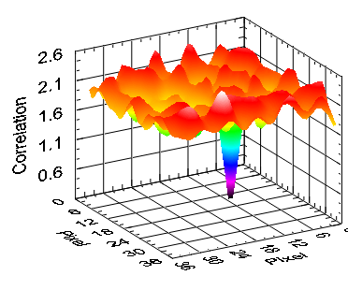
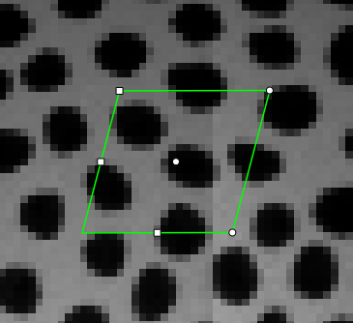
Introduction (2/3)
The three important components of 2D-DIC
Matching
Interpolation
Shape Function

Slide 4
Introduction (3/3)
DIC: easy and fast (or is it??)
Objectives
  Review each of these three components
  Understand the influence of some of the choices made there on results
  Understand how other choices are conditioned by these three components
  Provide understanding to make these choices in an informed way

Slide 5
Matching (1/11)
Finding the same pattern (one thing just like the other)

Slide 6
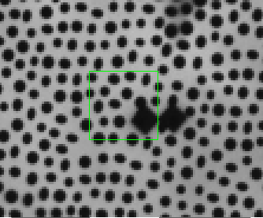
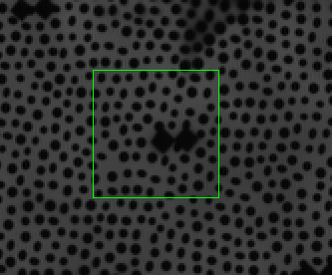
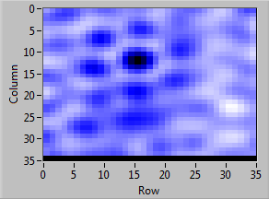
Matching (2/11)
Using interpolation and the shape function a correlation criterion is used to find a subset match
Subset to find
Region of Interest (ROI)
Etc.
Reference Image (F)
Matched Image (G)
How do you pick your correlation criterion?
Sum Squared Difference (SSD)
Normalized Sum Squared Difference (NSSD)
Zero Normalized Sum Squared Difference (ZNSSD)
χ – is the function to minimize
F – is the reference image
G – is the deformed image
i – is the pixel in the subset
Copyright 2013 Sandia Corporation
Notes:
There are a number of other functions that can be used: Cross-correlation, etc.

Slide 7
Matching (3/11)
The minimization function finds the motion and deformation of a subset simultaneously
F : reference image
G : deformed image
Summation over all pixels in subset
The parameter vector s relates coordinates in the reference image to coordinates in the deformed image.
A simpler notation for rigid-body-motion only.
How to select …. Speed vs. Image quality
Copyright 2013 Sandia Corporation

Slide 8
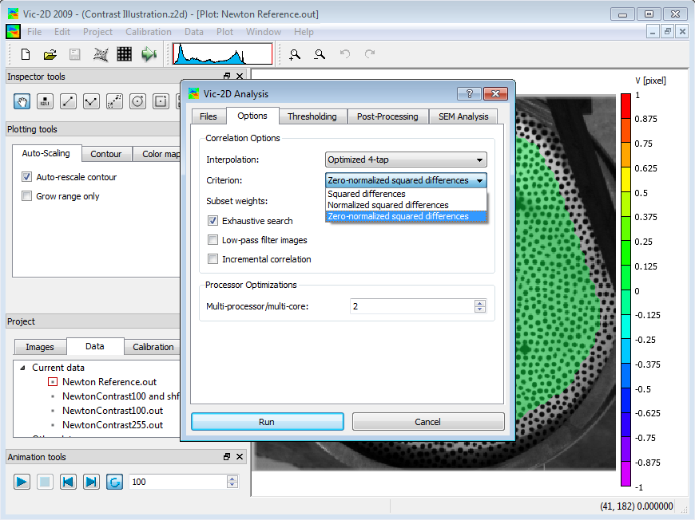
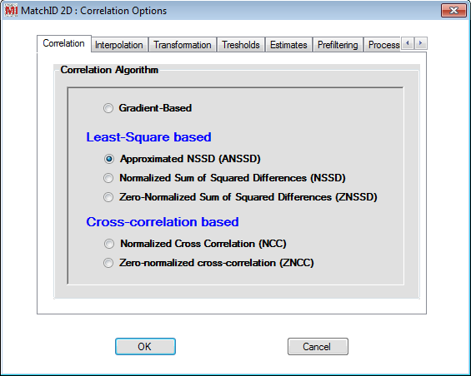
Matching (4/11)
Selecting your correlation criterion: Speed versus image quality
Copyright 2013 Sandia Corporation

Slide 9
Matching (5/11)
Images always have different intensities during the test. Particularly in 3D!
Full Contrast
Reduced contrast
Reduced and shifted contrast
Copyright 2013 Sandia Corporation

Slide 10
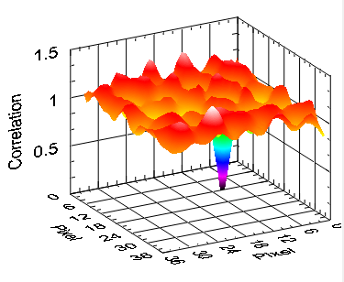
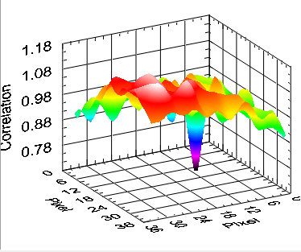
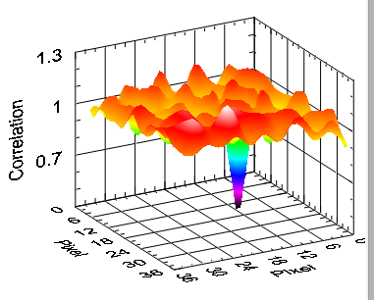
Matching (6/11)
SSD does not compensate for illumination differences
χ – is the function to minimize
F – is the reference image
G – is the deformed image
i – is the pixel in the subset
SSD Full Contrast
∆ = 0.94
SSD Reduced Contrast
∆ = 0.31
SSD Reduced & Shifted
∆ = 0.60
Copyright 2013 Sandia Corporation
∆ = 1 minus the minimum

Slide 11
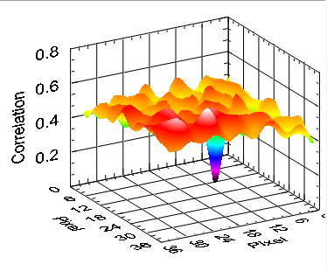
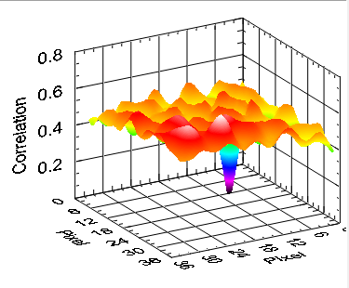
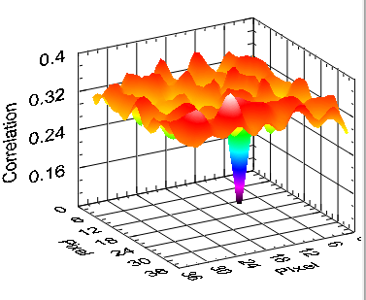
Matching (7/11)
NSSD is able to compensate for an offset in the image contrast
χ – is the function to minimize
F – is the reference image
G – is the deformed image
i – is the pixel in the subset
NSSD Full Contrast
∆ = 0.97
NSSD Reduced Contrast
∆ = 0.97
NSSD Reduced & Shifted
∆ = 0.91
Copyright 2013 Sandia Corporation
∆ = 1 minus the minimum

Slide 12

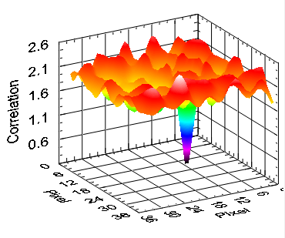

Matching (8/11)
ZNSSD performs equally on both shifted and compressed contrast
χ – is the function to minimize
F – is the reference image
G – is the deformed image
i – is the pixel in the subset
They are all the same – regardless of image lighting changes.
ZNSSD Full Contrast
∆ = 0.88
ZNSSD Reduced Contrast
∆ = 0.88
ZNSSD Reduced & Shifted
∆ = 0.88
Copyright 2013 Sandia Corporation
∆ = 1 minus the minimum

Slide 13
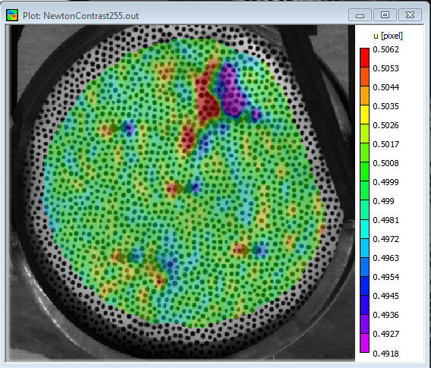
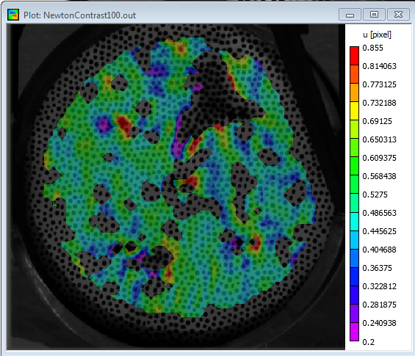
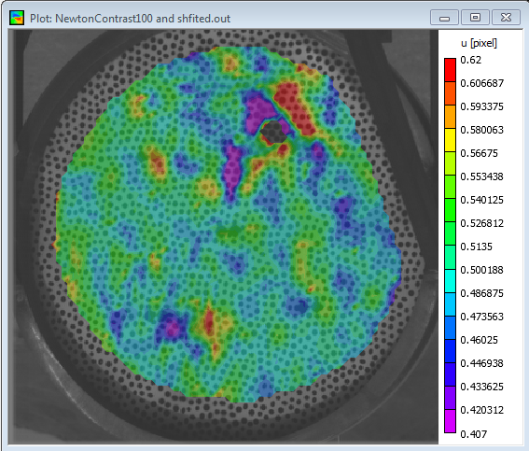
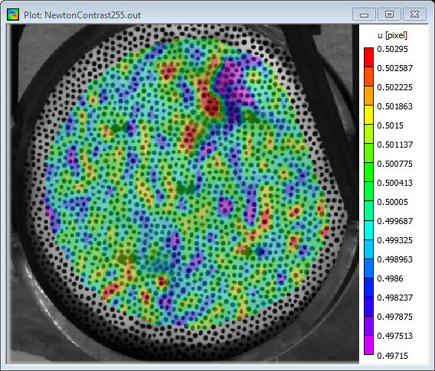
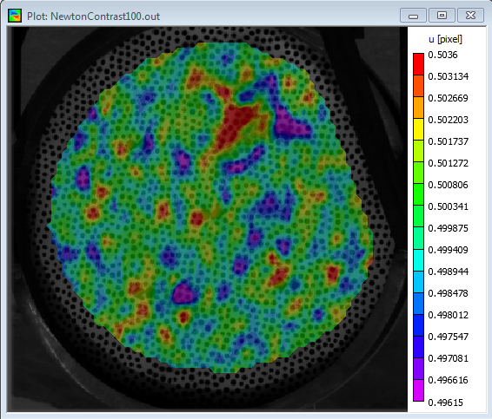
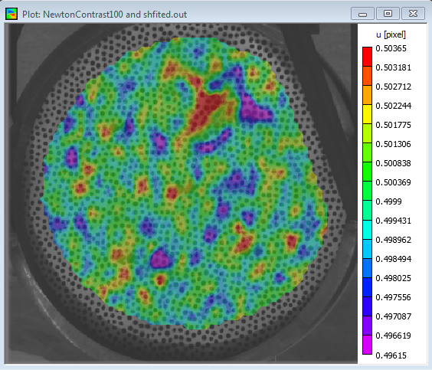
Matching (9/11)
ZNSSD performs much better on a wide range of image contrast variations
SSD
0.5062
0.855
0.62
SSD
0.4918
0.20
0.407
Displacement in pixels
ZNSSD
Copyright 2013 Sandia Corporation
0.5029
0.5036
0.5036
0.4971
0.4961
0.4961

Slide 14


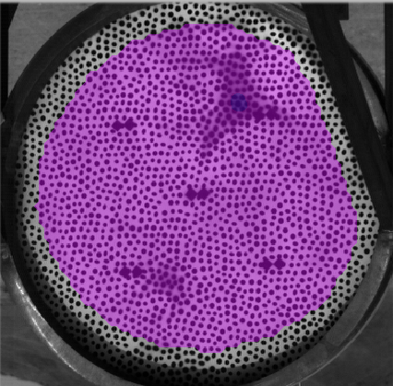
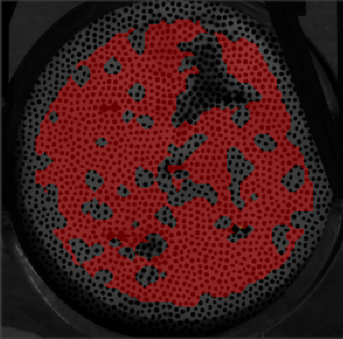
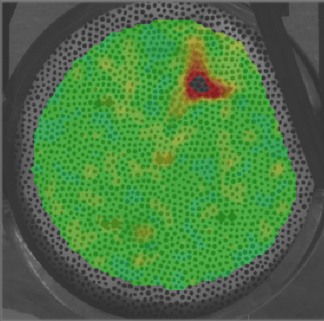
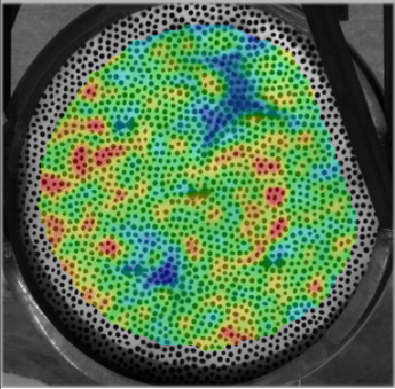
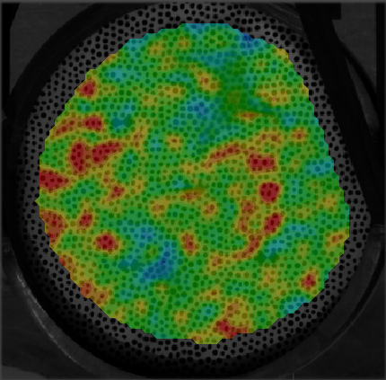
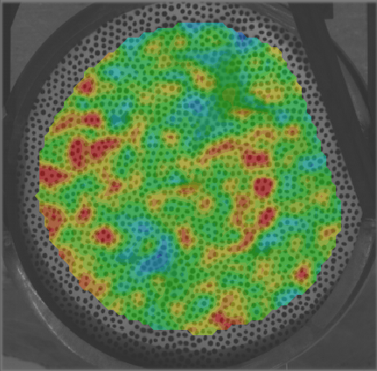
Matching (10/11)
The reported matching criterion (sigma) also shows that ZNSSD is better than SSD
SSD
ZNSSD
Copyright 2013 Sandia Corporation
Notes:
Sigma is the match quality reported by the DIC software. It is representative of the matching error.

Slide 15
Matching (11/11)
How do you choose your correlation algorithm?
  Lighting quality
  Solution speed – this has been ignored in the previous study
  ZNSSD is numerically more complex
Which correlation algorithm?
SSD or NSSD or ZNSSD
NSSD or ZNSSD
ZNSSD
?
Reference Image
Copyright 2013 Sandia Corporation
Deformed Image

Slide 16
Interpolation (1/9)
Interpolation – The information between the pixels (‘Reading between the lines’)

Slide 17
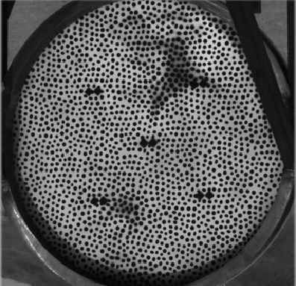
Interpolation (2/9)
Interpolation is a technique to find the data between sampled points.
Copyright 2013 Sandia Corporation

Slide 18
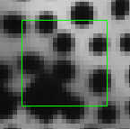
Interpolation (3/9)
The images are interpolated to be able to calculate a subpixel match
Image interpolated by a factor of 10x
210 x 210 pixels
21 x 21 pixels
Copyright 2013 Sandia Corporation

Slide 19
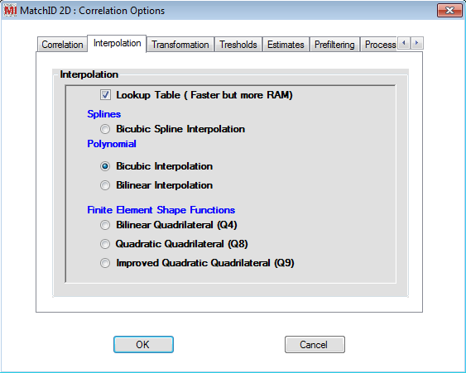
Interpolation (4/9)
You have a number of interpolation options: but not all of them are good!
Linear
Cubic Polynomial
Cubic Spline
Fourier Transform
Optimized filter (4-Tap, etc.)
What constitutes a good interpolator?
Matches the value at pixel locations
Minimizes the phase error
Minimizes the amplitude error
i.e. Minimizes the error in the matching of shifted images!
Copyright 2013 Sandia Corporation

Slide 20
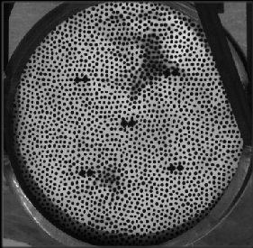
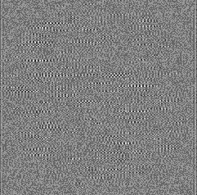
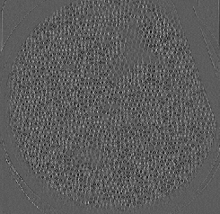
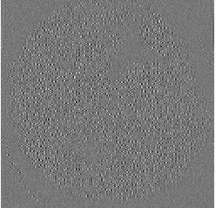
Interpolation (5/9)
The differences between the images are subtle but important
Original Image
σ – Standard Deviation of the grey values.
σ = 0 would be a perfect match
FFT vs FIR (~4-Tap)
σ = 0.61
FFT vs Linear
σ = 3.55
FFT vs Cubic Spline
σ = 1.43
Copyright 2013 Sandia Corporation
Notes:
The FFT has “more support” therefore is closer to the perfect sinc interpolation. All other interpolation functions are truncations and modifications of this.

Slide 21
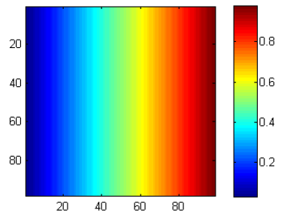
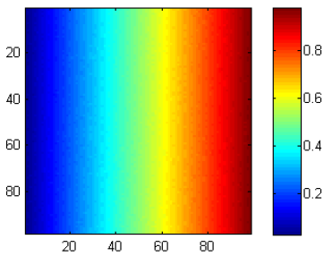
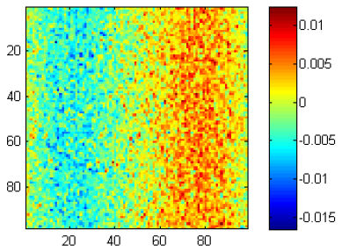
Interpolation (6/9)
Bias and random error: illustration
  Horizontal uniform elongation of a square FOV, displacement of 0 at the left, 1 at the right
Exact
Simulated DIC
Difference

Slide 22
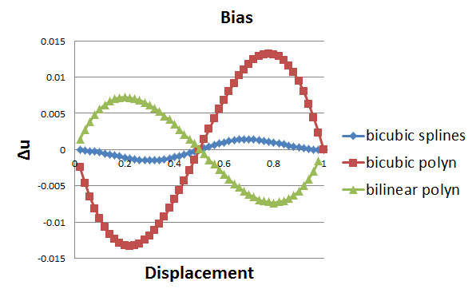
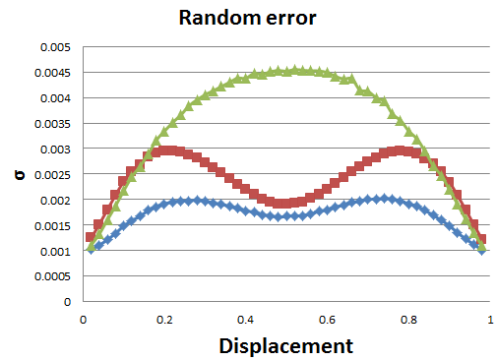
Interpolation (7/9)
A major error source in DIC uncertainty quantification!
1-D Translation
Schreier et al., Systematic errors in digital image correlation caused by intensity interpolation. Opt. Eng. 39, 2915-2921 (2000)
Copyright 2013 Sandia Corporation

Slide 23
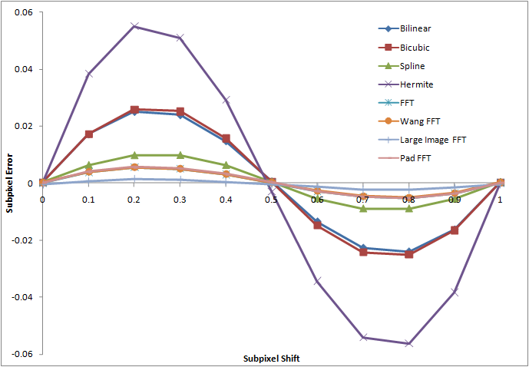
Interpolation (8/9)
Legacy interpolants caused phase and amplitude errors in the results
Copyright 2013 Sandia Corporation

Slide 24
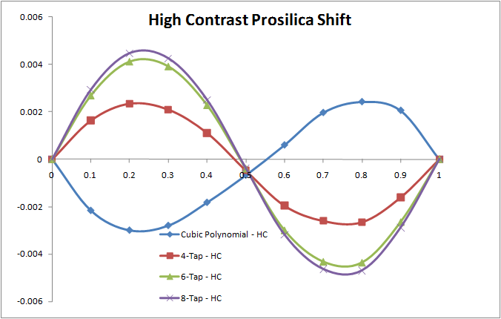
Interpolation (9/9)
Newer interpolants are no longer the largest error source in the DIC UQ chain
Copyright 2013 Sandia Corporation

Slide 25
Shape functions (1/5)
Subset shape functions (‘Constraining your solution’)

Slide 26
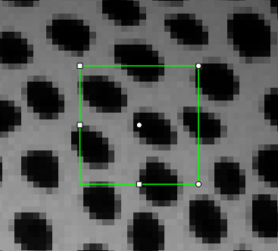
Shape functions (2/5)
Like finite element methods, the shape function matches the subset displacement
The affine Subset:
Translations (u, v)
Rotation
Scaling
Shearing
In some other codes higher ordered subsets exist. What are the advantages/disadvantages?
Copyright 2013 Sandia Corporation

Slide 27
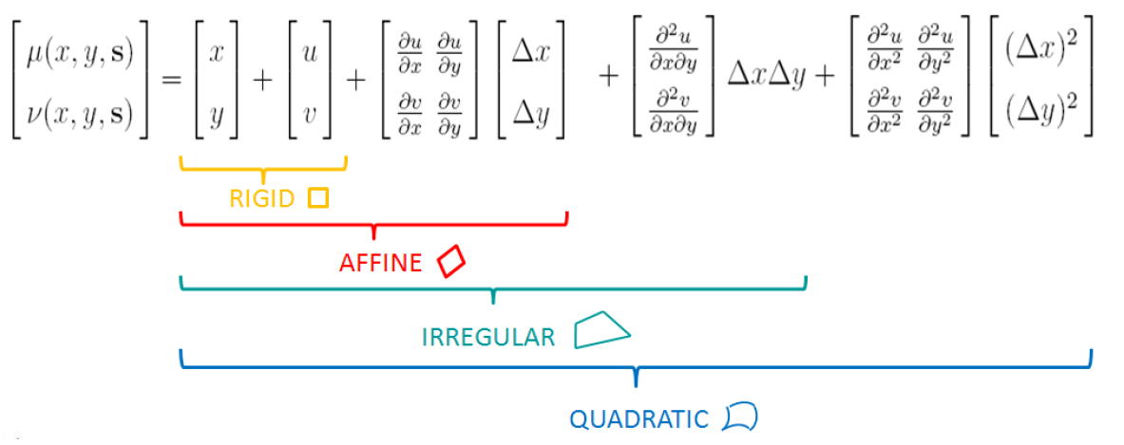
Shape functions (3/5)
Undersized subsets can lead to problems matching the shape or deformation
A linear shape function on a circle
Pascal Lava – KU Leuven

Slide 28
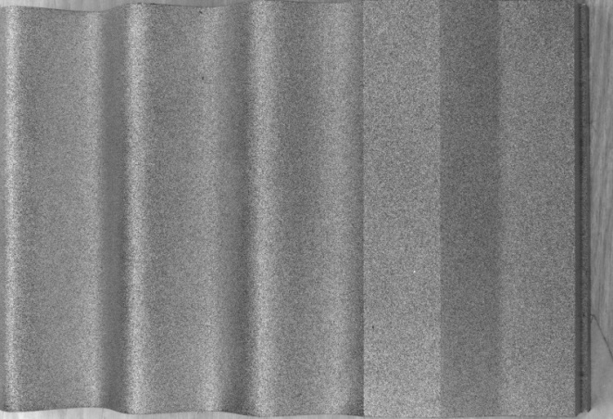
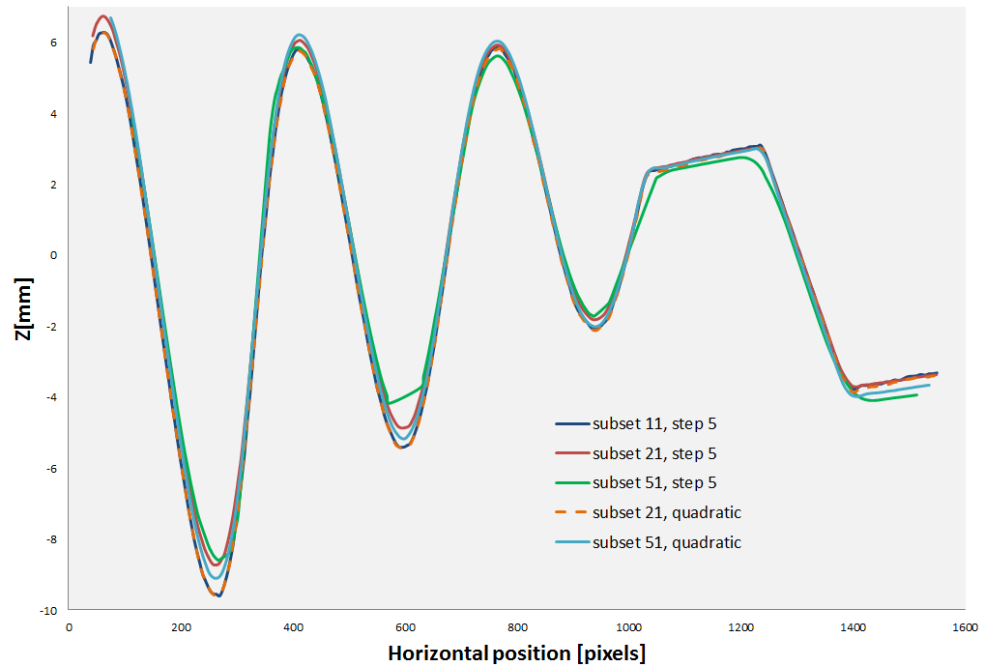
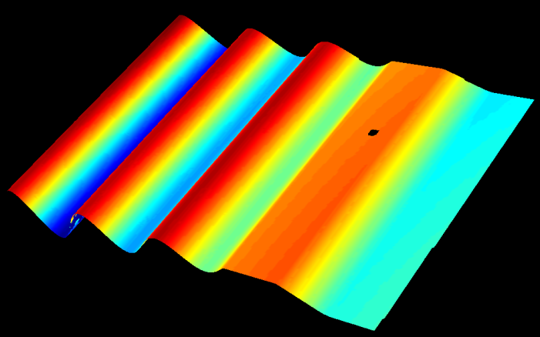
Shape functions (4/5)
Large subsets lead to lower spatial resolution

Slide 29
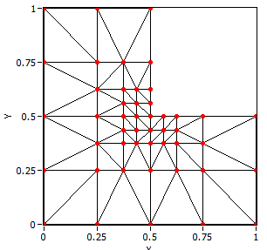
Shape functions (5/5)
Another approach is “global” DIC, where the surface is meshed and solved with an FE formulation.
Surface is meshed with elements.
Nodes are constrained to improve noise floor
X-FEM can deal with cracks.
Higher-order elements are OK.
A “regularization” length is still needed.
A priori information: dedicated shape functions
Tomičevć, Z., et al. (2013). "Mechanics-aided digital image correlation." The Journal of Strain Analysis for Engineering Design 48(5): 330-343.

Slide 30
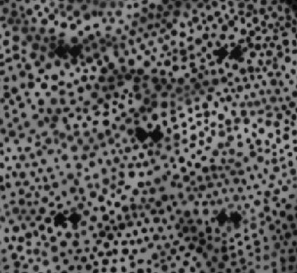
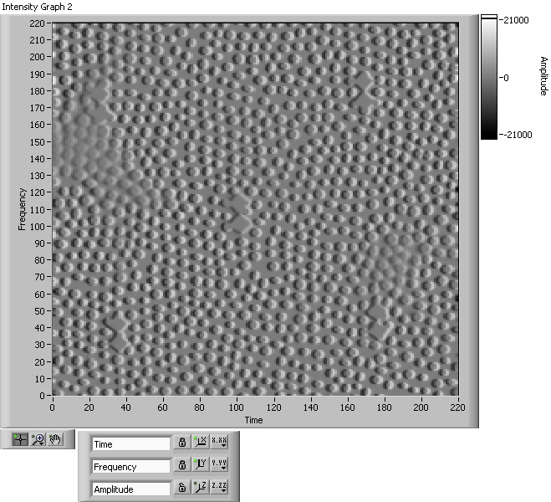
Uncertainty in DIC
The matching error is composed of a bias and variance term
interpolation
Systematic
Bias
Interpolation Bias
Noise Bias
Noise 5%
Noise 1.5%
Random
Variance
Measurement Variance
21000
Gradients =
=
0
-21000
Copyright 2013 Sandia Corporation

Slide 31
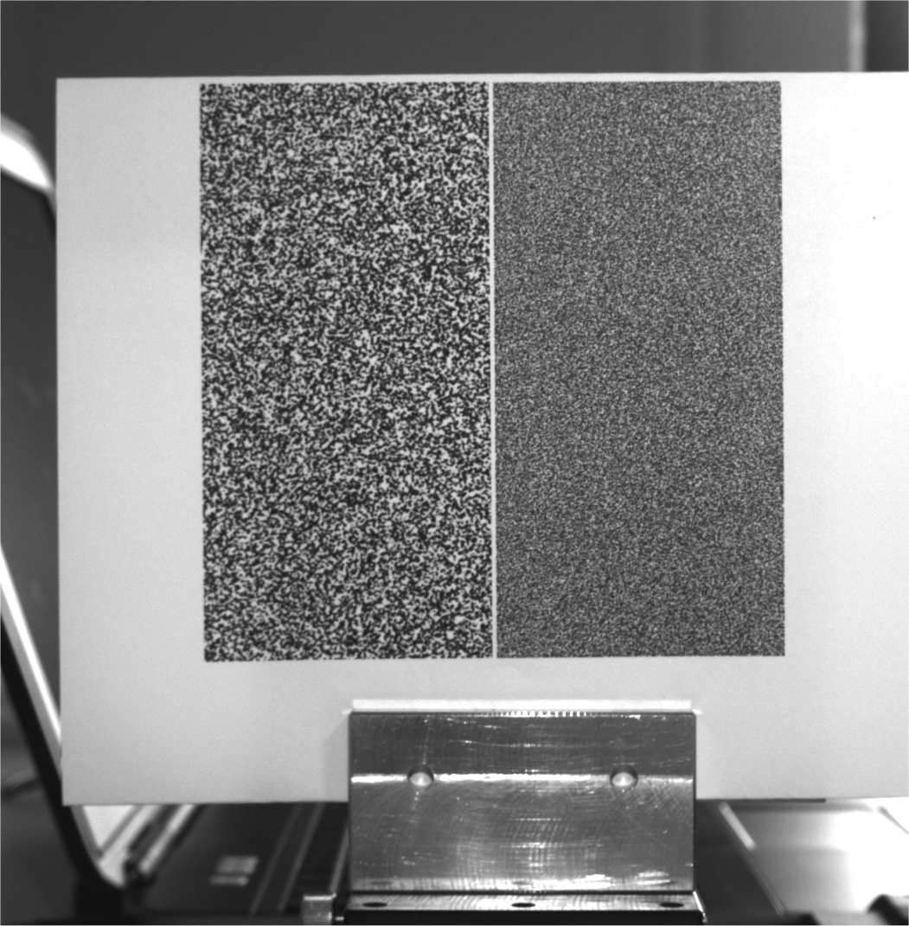
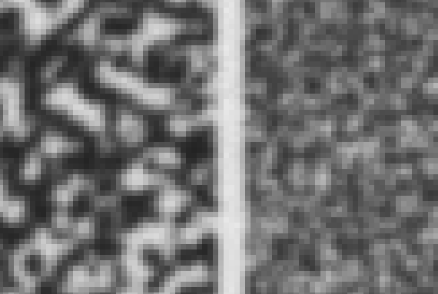
Interpolation bias (1/10)
Effect of aliasing
~1 mm
~0.3 mm
Average speckle size

Slide 32

Interpolation bias (2/10)
Out of plane mouvement
  Induces artificial ‘strain’ only in xx and yy components
  A good way to check for aliasing problems
Correlate the two set of images to evaluate aliasing error
stage

Slide 33


Interpolation bias (3/10)
Results
  5 mm out of plane translation
  Interpolation: bi-cubic polynomial

Slide 34


Interpolation bias (4/10)
Results
  5 mm out of plane translation
  Interpolation: bi-cubic polynomial

Slide 35


Interpolation bias (5/10)
Results
  5 mm out of plane translation
  Interpolation: bi-cubic polynomial

Slide 36


Interpolation bias (6/10)
5 mm translation
10 mm translation

Slide 37

Interpolation bias (7/10)
Effect of pre-filtering
Gaussian 5x5 pixels
prefiltering
No prefiltering

Slide 38
Interpolation bias (8/10)
Prefiltering blurs sharp edges
  Easier interpolation
  Unfortunately, increases noise
Systematic
Bias
Interpolation Bias
Noise Bias
Random
Variance
Measurement Variance

Slide 39



Interpolation bias (9/10)
Strongly aliased
Example
x
Linear interpolation
No prefiltering
Gaussian prefiltering (7x7)

Slide 40


Interpolation bias (10/10)
Effect of interpolation
Bicubic splines
Bicubic polynomials

Slide 41
Noise bias (1/3)
Systematic
Bias
?
Interpolation Bias
Noise Bias
Random
Variance
Measurement Variance

Slide 42

Noise bias (2/3)
Same speckle pattern, two different amounts of noise (2 and 8 grey levels)
Pattern rigidly translated by steps of 0.1 pixel
Mean displacement calculated for each step
Plot mean against translation step

Slide 43

Noise bias (3/3)
Results
  Bi-cubic polynomial, no pre-filtering
8 grey levels
2 grey levels
Displacement in pixels
Shift in pixels

Slide 44

Random variance (1/3)
Stationary pattern with increasing amounts of noise
  Calculate standard deviation of displacement

Slide 45

Random variance (2/3)
Effect of image averaging
  Take many images and average them for both deformed and undeformed
  Illustration: 50 images of stationary pattern
  DIC between image 0 and image 1
u: 0.0064 pixel
v: 0.0066 pixel
Standard deviation of

Slide 46
Random variance (3/3)
Effect of image averaging
  DIC between average of images 0 to 25 and average of images 25 to 50
u: 0.0019 pixel
v: 0.0017 pixel
Standard deviation of
Reduced by 3!

Slide 47

A practical problems (1/4)
Perpendicularity of camera wrt specimen
specimen
CCD sensor
Out of plane displacement

Slide 48

A practical problem (2/4)
Perpendicularity of camera
  Motorized stage, control angle
  Perpendicularity attained when displacement is uniform

Slide 49


A practical problem (3/4)
Example: vertical translation of 10 mm
Displacement non-perpendicular
Displacement perpendicular

Slide 50

A practical problem (4/4)
Example: vertical translation of 10 mm

Slide 51
Other cases (1/5)
Stereo-image correlation
  Matching issues same as 2D DIC
  Extra error sources: 3D calibration process
  Some issues become obsolete: perpendicularity, out of plane movements
  UQ is more complex because of calibration
  Still under development

Slide 52
Other cases (2/5)
Digital Volume Correlation
  Extension of DIC to volume data
Different sources
  X-ray CT
  Confocal microscopy
  Optical Coherence Tomography (OCT)
  MRI
  Sheet illumination for transparent bodies
  …

Slide 53


Other cases (3/5)
Examples: X-ray CT of bone*
*: Gillard et al., JMBBM, 2014

Slide 54


Other cases (4/5)
Examples: OCT of porcine cornea*
Inflation test
*: J. Fu, P.D. Ruiz, F. Pierron (PhD of J. Fu), 2014

Slide 55
Other cases (5/5)
Digital Volume Correlation
  Same issues as 2D matching
    Interpolation, aliasing, noise etc.
  Stationary and rigid body motion tests to evaluate performances
  More difficult to induce ‘strain’ by change of magnification (under way)
  Uncontrolled ‘speckle’ pattern: related to material
  Imaging system induces ‘distortions’ (refraction in OCT, ring artefacts in X-ray CT etc.)

Slide 56
Conclusion
DIC is a complex measurement technique
Many choices have to be made, which impact the results
No magic recipe: need for understanding the different issues
Qualitative vs quantitative DIC: a step change
Need for training
More in the data processing lecture

Slide 57
Some useful resources
International DIC society: http://idics.org
Guide of ‘good practice’ (iDICs)
  http://idics.org/guide/
Training
MatchID DIC course
  Five successful 5 days sessions in 2014-2017
  Next edition: 11-15 June 2018, Philadelphia, USA
  https://www.matchid.eu/Portal/?user=DIC_Course

Slide 58
Acknowledgements
Dr Pascal Lava, MatchID N.V., Belgium
Dr Philip Reu, Sandia National Laboratory, USA

